Slide 1
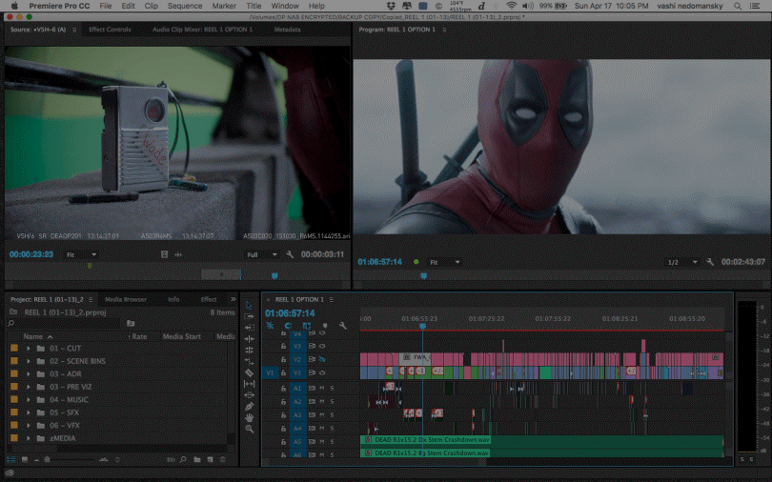
Video Editing Software
Abbigail Lynn Rennes
Post Production Supervisor | Lead Editor

Slide 2
About Me
Editing for 7 Years
Post Production Supervisor | Lead Editor – Film Company
Freelance Independent Feature Film Editor (non-union)
Owner: Abbi Lynn Media LLC
BA Film and Video (Film School) | MA Digital Media (Graduating this year)
Worked on Top Chef, Music Videos, Shorts, Features, Corporate, Weddings, Church Media, etc.
Very Excited to be here today!!!!!

Slide 3
My Goals for This Talk
Learn a little bit more about what a film editor does.
Learn more about what software we use and why we use them (the main ones)
A Glimpse into a short film Timeline (and wedding if time)
Learn a little bit about the different types of workflows that aid our software decisions
How you can get started in film editing today? Free software to get you going and practicing today.
Career Opportunities

Slide 4
What does an Editor Really Do?
1.TECHNIICIAN
Goes through every clip and finds the usable and unusable parts of a clip.
Sorting through all the usable clips to find the BEST usable clips.
Assembling a timeline of all the usable clips by fractions of a second to create an entire completed film.
2.COLLABORATOR
Works with cinematographers and sound editors to bring sight and sound together.
3.ARTIST
Captures a director’s vision and tells a compelling (and hopefully effective) story.

Slide 5
Other Things Editors Can Do
On an independent basis, Editors have far more responsibilities.
Sync Sound Color Grading
Sound Mixing Music Insertion
Graphic Design Graphic Animation (Motion Graphics)
VFX (Visual Effects | Computer Generated Imagery)
Virtual Reality
Opening|Closing Credit Sequences
BOTTOM LINE: A LOT OF RESPONSIBILITIES, AND A LOT OF KNOWLEDGE TO AQUIRE

Slide 6
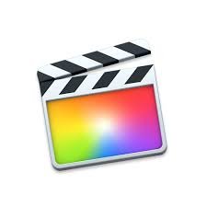
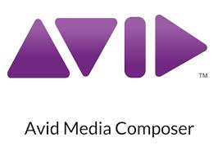
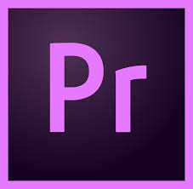
What Tools do we Use?
The Editing Software we Use Depends on…
WORKFLOW (Offline/Online, Camera Used),
BUDGET (provided, requested, paid for),
and TEAM MEMBERS (what software works with everyone else’s better).
THREE MAIN PROFESSIONAL SOFTWARES For Film Editing (NLE)
Avid Media Composer Adobe Premiere Pro Final Cut Pro X

Slide 7
Why Video Editing Software?
Before…we used to cut on film
Copies of the film were made, and people literally cut the film and glued them together to make an entire film (moviola)
We also called this Destructive Editing. Why? Because you can’t UNDO your work.
Then, We cut on Tape
Linear Editing System | Also Destructive Editing
https://www.videomaker.com/article/c3/1214-edit-points-linear-vs-nonlinear-editing
AND Then, Film Editors wanted to work faster… and Non-Linear Editing Softwares (NLE) were Born,
Why do we like them? Non-Destructive Editing
What is Non-Destructive Editing?
is a method of editing that allows you to make changes to a file without overwriting the original file on the harddrive.

Slide 8
What Does That Look Like?
Let’s Look Closer At Premiere Pro
Showing the non-destructive side of an NLE
How we organize files
Timeline Elements (color labels)
Different Workspaces for Different jobs
Programs are customizable to suit your preferences
No program is the same.

Slide 9
When to Use What? WORFKLOW
As an editor decides what software they use, the first ask themselves…
“Is this going to be an OFFLINE or ONLINE editing workflow?”
OFFLINE: raw footage is copied and the copy only is then edited, thereby not affecting the camera original film stock or video tape.
ONLINE: editing the camera original film stock or media files. Also used in the finalizing process.
How that Influences My Decision
Offline|3+ Members Offline & Online | 1-2 Members Online | Me

Slide 10
Keep in mind…
Most Feature Film Projects do a Offline → Online workflow.
Assistant Editor or Digital Image Technician makes copies of the original files in lower quality (proxies)
The lower quality files (proxies) get edited in a Non-Linear Editor
The Editor then exports what is called a Edit Decision List (EDL)
EDL: A computer’s map to reassemble the timeline without using the editor’s project files.
Why do we do that? To protect the Editor’s work, and it’s faster.
There are different EDLs for Different Needs (Sound, Color)
The Colorists & Finishing Team reassembles the timeline using the EDL in a finishing software (normally for color grading | sound) with the original camera files
The Finishing Team brings the final sound and picture together , and then sends it to the studios to bring into theatres

Slide 11
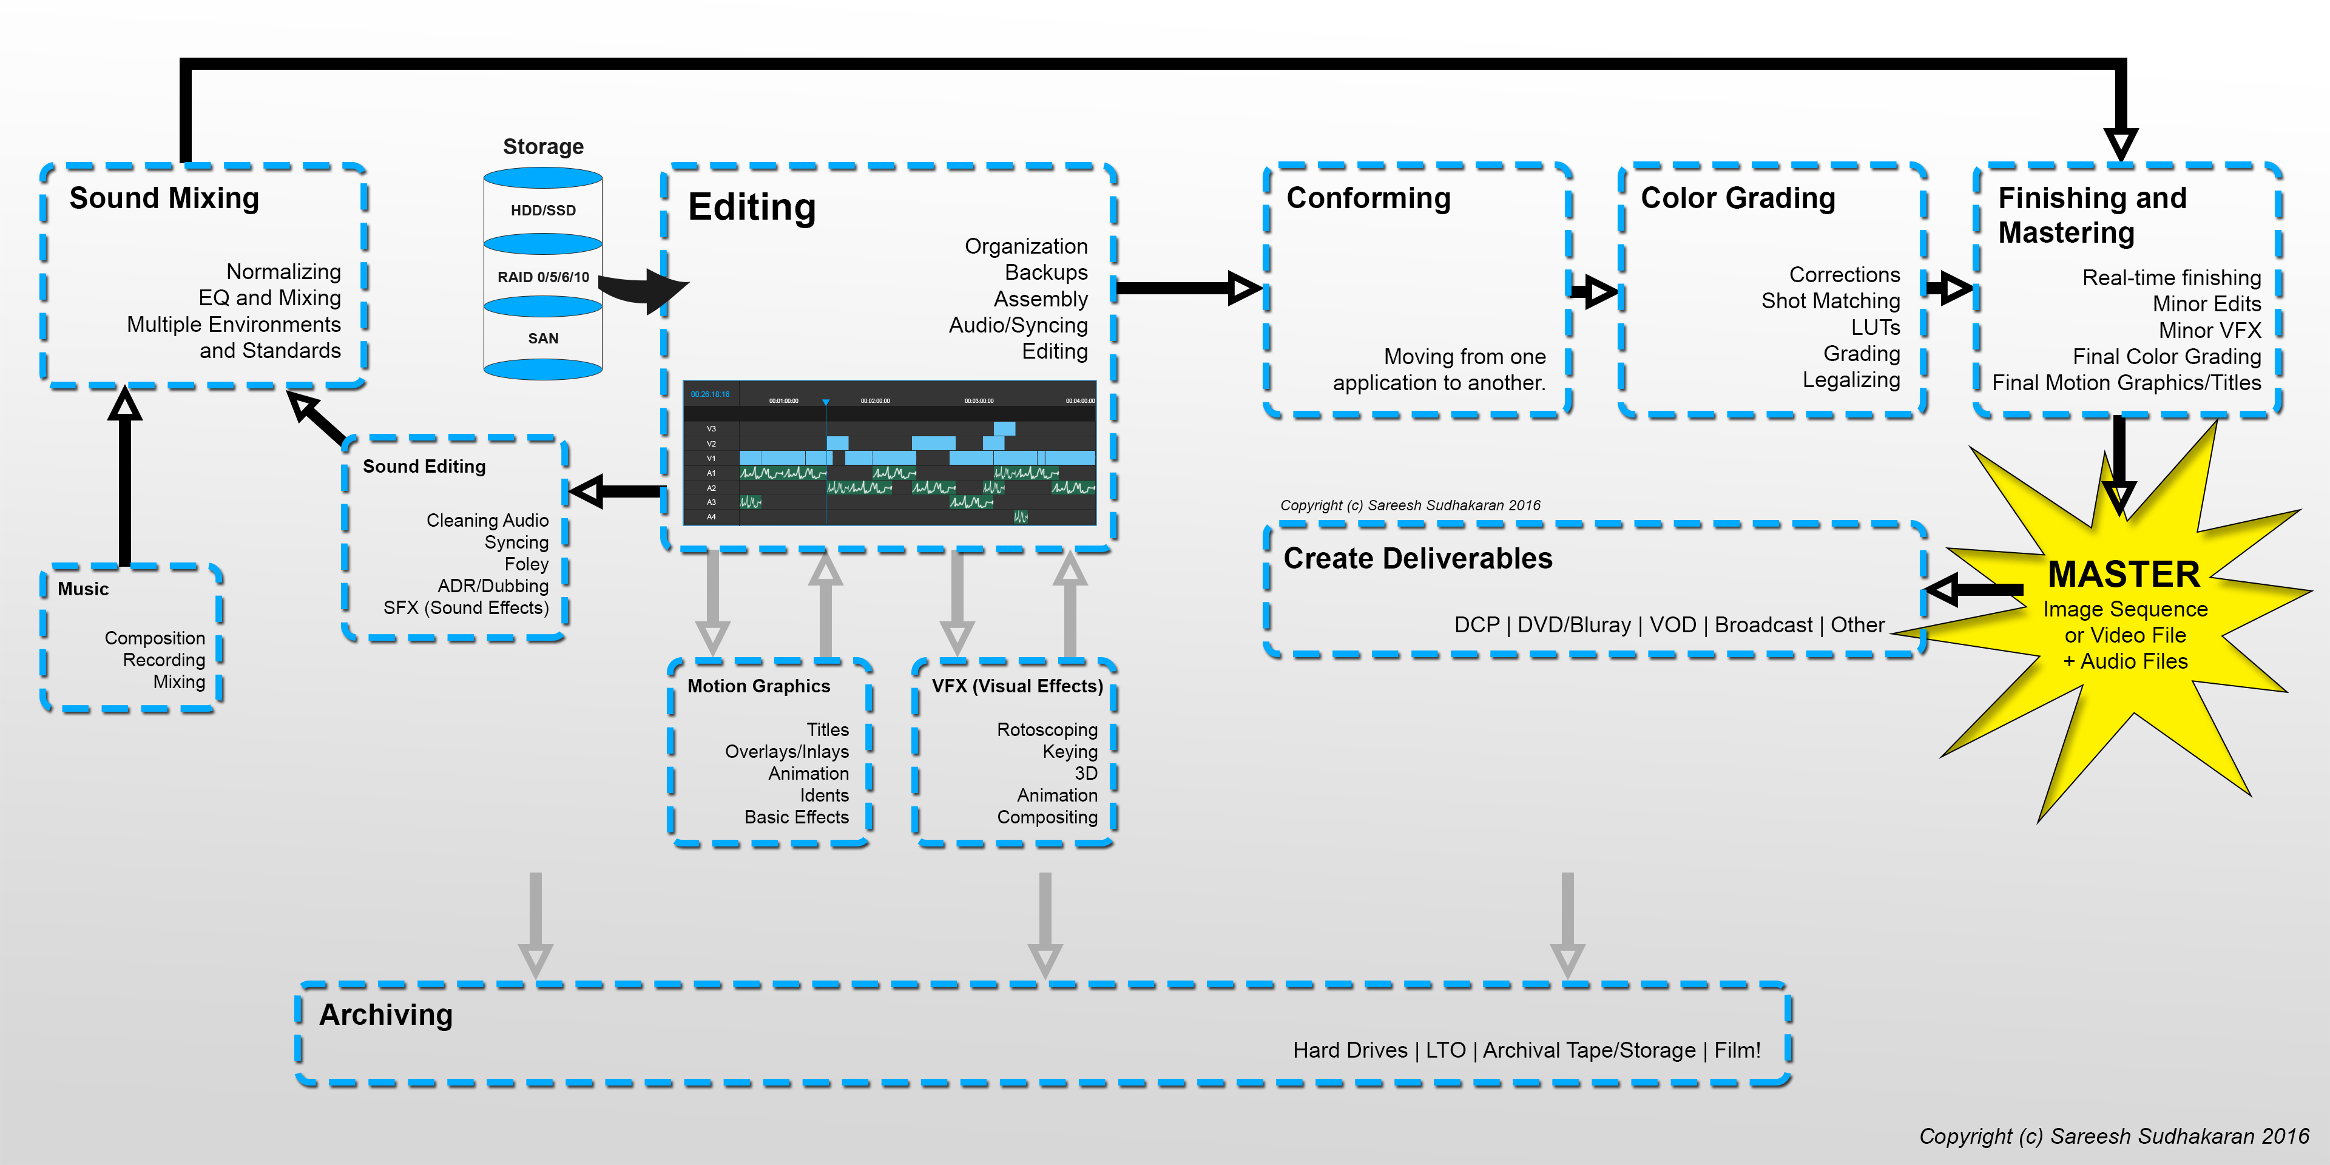

Slide 12
When to Use What? Budget & Team
Solo|Small Team Editors Use Premiere Pro or Final Cut Pro X. Why?
It is much cheaper than using Avid.
A little bit easier to learn. (more approachable)
Larger Teams of People working on Constantly Updating the Software All the time
Designed for a person who does A LOT of Jobs
Assistant and Lead Editor, Independent Film Editors
The industry standard right now is Avid Media Composer. Why?
Because it has tools that work well with a large amount of people looking at the same footage and software at once (producers, directors, teams of editors, etc.)
It works well with Pro Tools (the industry standard for Audio)
Coincidence? No. Avid Designed Pro Tools.
The language in that software is designed for film editors
Certain trimming tools are very appealing for editors
It was designed FIRST (everyone learned this is a senior editor now)
No constant updates that mess with large scale productions
It is designed for SPEED (with loads of practice, studying, and training)
It is a difficult software to learn.

Slide 13
Career Opportunities for These Skills
Post Production Supervisor
Visual Effects Artist
Film Director
Digital Image Technician
Colorist
Animator
2D & 3D
Motion Graphic Designer
Sound Designer/Mixer
Dialog Editing
Editing (Of Course)
Assistant Editor

Slide 14
How Can You Start? Software
Avid Media First: a free version of the software for you to get started and learn Avid
iMovie: a great introduction to learning the techniques of editing
Windows Movie Maker
Lightworks
HitfilmExpress: Additional Add-Ons cost a charge
Davinci Resolve Lite: Free and can Edit Video
The pro-version is very popular for color grading

Slide 15
Where do I go to Learn Editing?
Film School
A formal education will give you the full picture to be a well-rounded editor
More reputable in the job market
Online Courses
Master the Workflow
Avid Certified Training
Adobe Certified Training
Masterclass/Bootcamps
Note: Being Certified in Software is VERY important for landing larger budget jobs.
Software Manuals
Hard copies are extremely handy
There are film editors that write books on shortcuts and workflow tricks as well
Theory Books (learn the basics of the software first)
“The Eye is Quicker” by Richard Peppermen
“In the Blink of an Eye”

Slide 16
Q & A

