Slide 1
Mitch Zamara Game Designer @mzamara http://www.mitchzamara.com

Slide 2
About Me
In the Video Game industry for 9 years.
Started as a Game Tester

Slide 3
So what does a game designer Do?
I’m in charge of coming up with creative and fun ideas.
I have to figure out how much items cost or how many coins you get for selling something.
I get to make games fun!
“Game Designer” is a broad term.
It has a few areas of specialization:
Systems Designers
Content Designers
Level Designers

Slide 4
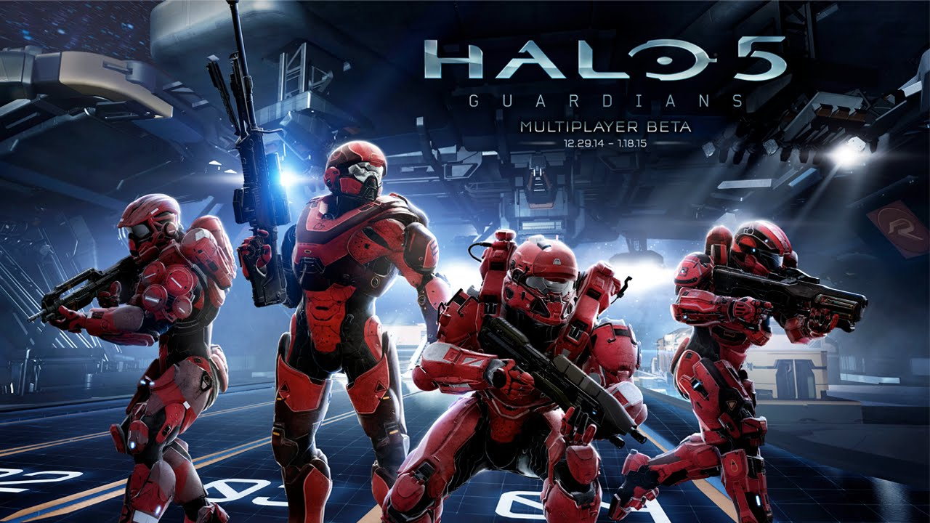
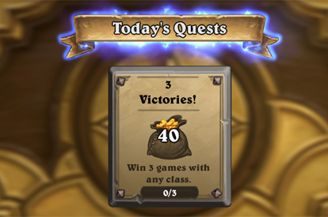
Systems Designers

Slide 5
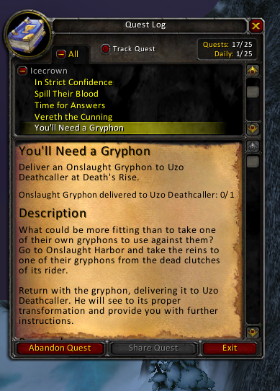
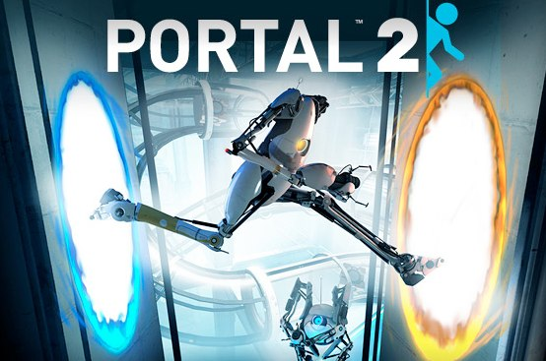
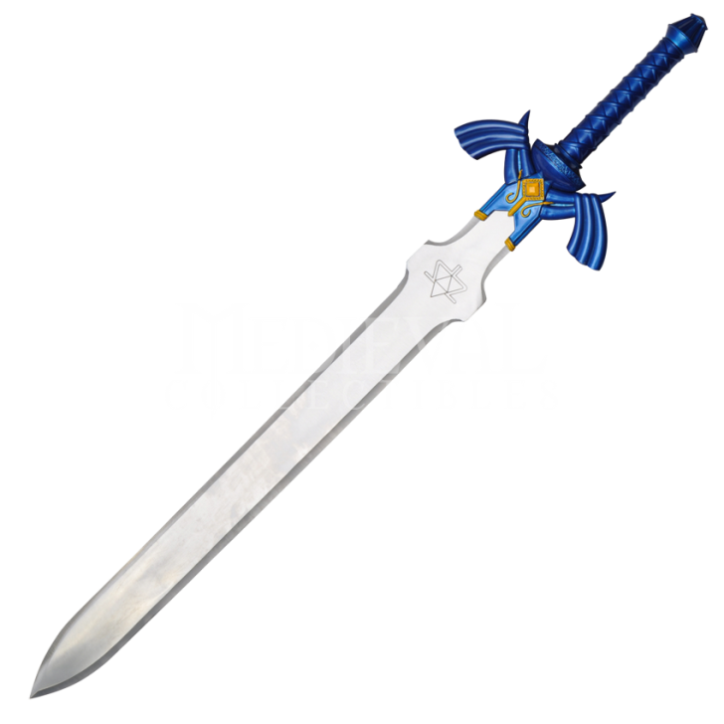
Content Designers

Slide 6
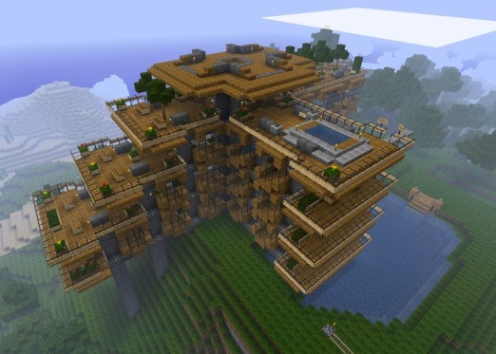
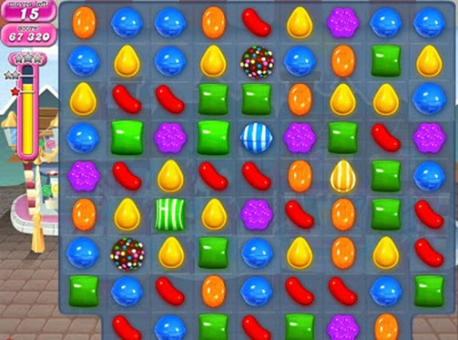
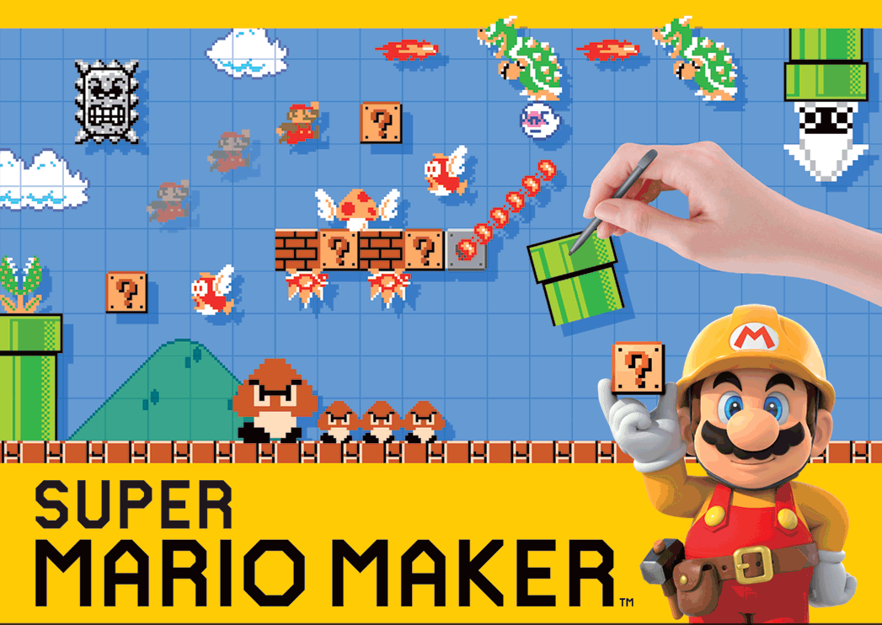
Level Designers

Slide 7
Game Development – Team Roles
Game Designers
We make the fun! We're the architect that comes up with the blueprint for the game.
Degree: Game Design
Average Salary: $73,864
Artists / Animators
Create all the art for a game. Drawing or animating characters, designing the menu's, the backgrounds, etc...
Degree: Fine Arts.
Average Salary: $74,349

Slide 8
Game Development – Team Roles
Programmers / Engineers
They program the game by writing code. Code is a set of instructions that tell a computer or game console what to show on the screen, and what to do when you press buttons.
Degree: Computer Science
Average Salary: $93,251
Product Managers / Business
They're the business people that are in charge of making sure the game makes money. Ever paid for DLC? Bought an extra life in Candy Crush? They are the ones who usually come up with how much those things cost.
Degree: Business, MBA
Average Salary: $73,500

Slide 9
Game Development – Team Roles
Producers / Project Managers
They're in charge of making sure everything goes according to schedule. They also help with communication, so everyone knows what the rest of the team is doing.
Degree: Project Management, PMP Certification, MBA
Average Salary: $82,286
QA Testers
The ‘mailroom’ of the videogame industry. You are paid to test games, and find problems (bugs). You do not have any say over what game you test. You might be hoping to test the next Halo, but end up testing the new Barbie Horse Adventure!
Degree: Not needed
Average Salary: $54,833

Slide 10
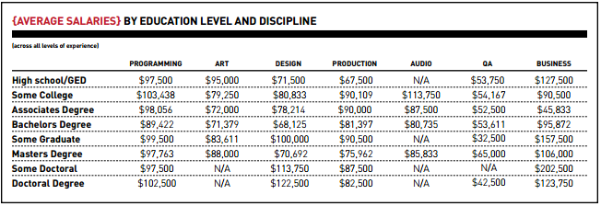
More Salary Info
https://www.gamasutra.com/salarysurvey2014.pdf

Slide 11
Game Design Skills & Questions
Where do designers get their ideas?
Other Games!
Movies, Tv, Books, Comics, etc..
A thirst for knowledge.
How long do games take from start to release?
Depends on the type of game, and the platform its for.
Mobile Games: 3-6 months for a small game like Candy Crush. Up to 1 year for a bigger game like Clash of Clans.
Console Games: 1-3 years, depending on the team size, and how big the game is.

Slide 12
Game Design Skills & Questions
What is the most enjoyable aspect of this career?
Making games that millions of people play.
Talking with fans and players, and seeing their passion for what I made.
Having a ton of fun.
What is the most tedious aspect of this career?
Long hours. 60 hour work weeks are normal.
“Crunch time” = working on weekends.
Not always having the say in decisions.
Not getting to pick what game to make.
The “Business” side of things.

Slide 13
Any other questions?
Mitch Zamara Game Designer @mzamara http://www.mitchzamara.com

