Slide 1
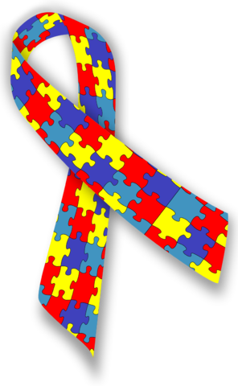
Autism Networking
App
Created By: Sarah Turner,
Hailey Brooks, Makenna Orel,
& Mikayla Felice

Slide 2
Articles
Screen Title
App Home Page:
Products
With one in every 68 kids now being affected by Autism our goal was to build a network for those affected and their family and friends.
Chat Room
Interactive

Slide 3
Articles:
This section of the app is designed for families and friends to get more information about Autism. We hope that more understanding will lead to more acceptance.
Articles
What is Autism
Therapies

Slide 4
Products:
Products
General Autism Products
This is for people who have Autism or their families to purchase products that are reviewed and known to help Autistic symptoms. This could help people research and find new things that could help them or their loved one.
Autism Support Products
Weighted Blankets
Brain Supplements

Slide 5
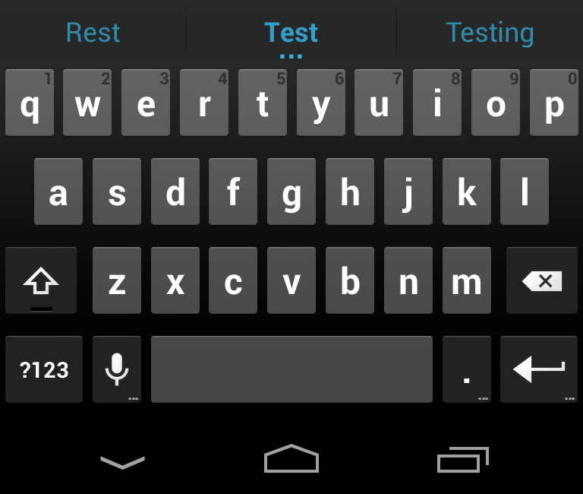
Chat Room:
Chat Room
The chat room is an easy way for the person affected and their families to get into contact with others in their situation. They are able to share experiences of what worked and didn’t work for them so that others can view what people in the community are trying. It also offers the opportunity to create a supportive community of those who can understand what each other might be feeling and can offer advice from their own experiences. This isn’t to replace medical professionals but can be comfort to people when they feel they are alone in their situation.
Sara: My son can’t stand the bus since it is so loud but we don’t have any other way for him to get to school. Any ideas how to help?
John: We got noise cancelling headphones for my brother and that helped him when he had to ride the bus.

Slide 6
Interactive:
Interactive
Games
The Interactive section of the app is designed for people who have Autism. This section includes games that vibrate while you play them to help with users who suffer from sensory overload, a journal so the user can write how they are feeling or what is going on in their life, and calming music.
Journal
Music

Slide 7
Games:
Games
We would like this section of the app to help users with furthering motor skills, their ability to communication, and other various aspects that the users may need to improve. We also hope this section can act as a distraction and help with sensory overload.

Slide 8
Journal Entry Page:
This is for affected people to note anything that happened that day, any treatment that worked, or certain feelings. This is helpful to the Doctors and Occupational Therapists when trying to help the Autistic person find ways to treat their symptoms.
Journal
Today I had these feelings…
Sadness
Loneliness
Anxiety
I experienced this…
The need to act out
I tried this…
Using the breathing treatments when I was feeling anxious, IT WORKED!

Slide 9
Music:
Music
The music section will be a playlisted filled with calming music and breathing exercises to help calm and relax the user.
Ocean Waves
Meditation Music
Breathing Exercises
Instrumental Tunes

