Slide 1
Information Security ……PLOTTING YOUR PATH
March 10th , 2017

Slide 2
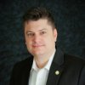
Presenter
Eric Yancy, CISSP, CCSK, CISM, CISA, NSA-IEM
Information Security Officer, Sabre
eric_yancy@yahoo.com
March, 10, 2017

Slide 3
Agenda
Introduction to Sabre
Technology
Threat Actors
Innovations
Your Career
Questions/ Answers

Slide 4
Introduction to Sabre
Car Rental
Rail Lines
Tour
Cruise Lines
Ground
Transportation
OUR MISSION
An innovative technology company that leads the travel industry by helping our customers succeed
Hotels
Entertainment
Airlines
Travel Protection
Notes:
What makes Sabre different and a great partner for your business?
Sabre comprises three core brands…with a number of key industry leaders in each…
Sabre Travel Network provides technology services to the travel industry. It operates the world’s largest travel marketplace, connecting travel buyers and sellers. Our innovative technology connects 370,000 travel agents to more than 400 airlines (more than 100 are low-cost carriers; access to more than 800 airline schedules), more than 125,000 hotels (more than 300 chains in 200 countries), 27 car rental brands (30,000 locations in more than 160 countries), 50 rail providers (including multi-modal booking with Eurostar), 16 cruise lines and other global travel suppliers. More than $110 billion of travel is purchased through this marketplace annually.
Sabre Hospitality Solutions provides technology to the global hospitality industry. It operates one of the industry’s largest Software-as-a-Service (SaaS) businesses. Its reservations and property management system, marketing and distribution software, and Internet marketing and e-business solutions are used by more than 12,000 hotel properties around the world. Each year, it generates more than $12 billion in revenue for its customers.
Sabre Airline Solutions provides technology to the aviation industry. It operates the industry’s largest Software-as-a-Service business. Its reservations system and operations, marketing and planning software are used by more than 380 airlines and over 100 airports around the world. More than 450 million passengers are put on airplanes every year using Sabre technology.
We’re all about helping you make your customer’s next journey something to write home about.

Slide 5
Largest Tech Company You’ve Never Heard Of
5 billion API calls / day (April 2010)
5 billion API calls / day (October 2009)
3 billion API calls / day, 75% of all traffic (April 2010)
1 billion API calls / day
267 million API calls / day (Q3 2009)
100 million API calls / day (March 2009)
37 million API – delivered stories / day (March 2010)
Over 50% of all traffic via API (March 2008)
Over 100 billion objects stored in S3 (March 2010)
Source: www.readwriteweb.com

Slide 6
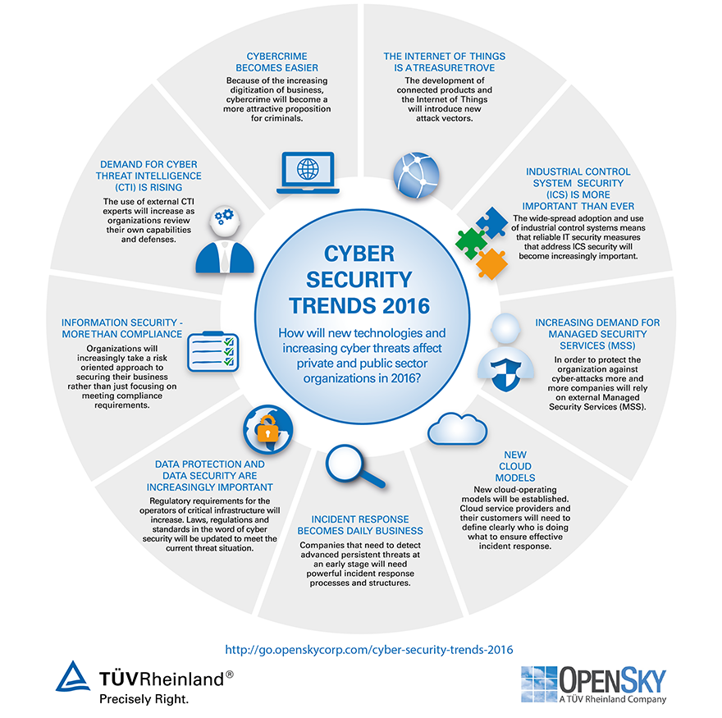

Slide 7
Information Security - Technology
Operating Systems (Linux / Windows / Mobile)
Programming languages (Python, Java)
Intrusion Detection
Firewalls
Behavioral Analytics (East / West)
Big Data analytics
File Integrity Monitors (FIM) – TripWire
Security Event Incident Management (SEIM) – Secure Works / Splunk
Cloud (Microsoft Azure, Amazon AWS)
Security Operations Centers (SOC)

Slide 8
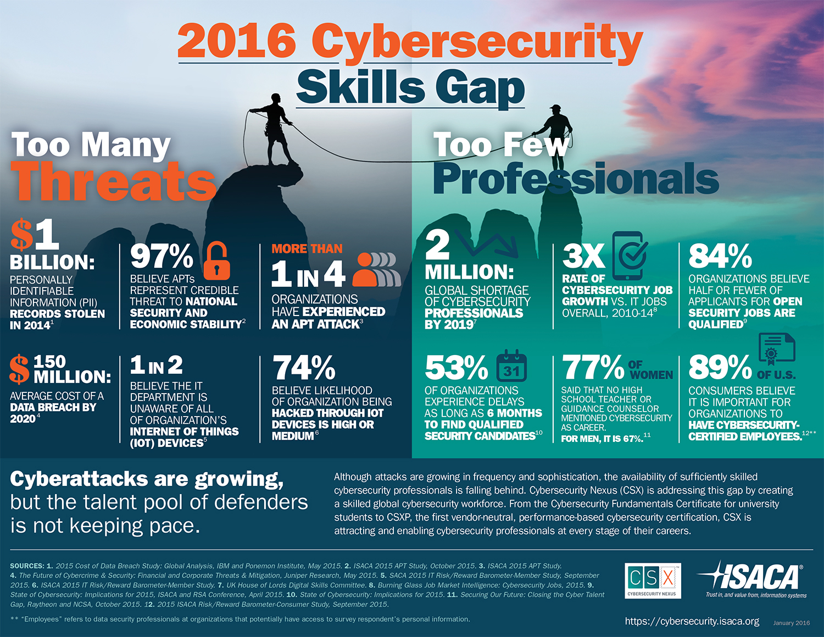

Slide 9
Threat Actors
Internet Of Things (IoT)
Nation States – Cold War (45% embargo on China)
Hacktivists (Anonymous)
Cold War – German Power Plant, Iran Nuclear Centrifuge
Improved Tools (next, next, finish) – Metasploit, Kali
Bot Net
Terrorists
Organized Crime
Ransomware, Phishing, Whaling, Malware, etc.

Slide 10
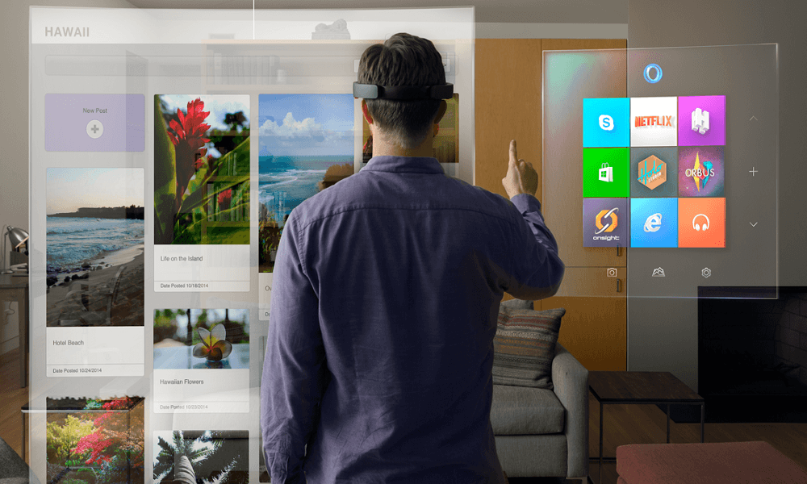
Innovations – Future State
Wearable's (contact lenses)
IoT (home automation, shopping, entertainment)
Drones
User Interfaces - Flexible screens, voice, augmented reality
Robotics (Biometrics, Medical Devices)
Autonomous Cars (Ethics issues)
Embedded Devices (SCADA) – InfraGard
Virtual Reality
3D Printing

Slide 11
Your Career
Huge Delta / Deficiency
Salary
Huge Diversity (mile wide, inch thick)
Seek an Internship
Get Certified (CISSP, CISM, CISA)
IoT and Cloud
Create Your Brand
Get a Mentor or Coach

Slide 12
Learn the basics:
Learn Linux: Most security takes place at the scripting level, therefore, you need to become extremely familiar with the Linux operating environment.
Scripting Skills: Build on basic coding skills (Python, ruby etc) to build tools etc.
Learn penetration testing: .
Focus on one area first:
Networking
Database
Application development (SDLC)
Build your own lab (virtual machine / KALI)

Slide 13
Early Career Paths
Become a QSA or work for a company performing gap analysis.
Work as a system administrator or network engineer.
Learn penetration testing as many companies accept newbies in this field.
Start out as an analyst in a SOC or Incident Response area.
Focus on AppDev and WebApps
Get a degree is from a US University that has a Cyber Security or Information Security program.
You may also want to explore working directly with the US government (FBI, CIA, NSA), specifically if you have language skills other than English.
Networking: Never underestimate the power of networking. If there are local ISC2, ISSA, or ISACA chapters, attend a meeting and network.

Slide 14
Certifications:
You may want to start off getting some basic certifications which don’t require experience such as:
Network+
CompTIA Sec+
OSCP – Offensive Security Certified Professional
Once you are experienced, you could further your career by getting these certifications: ISACA, ISC2, GIAC
CISA – Certified Information Systems Auditor
CISM – Certified Information Security Manager – Requires more proof of experience than CISSP
CCSK / CCSP Certified Cloud Security Knowledge / Professional
CEH – Certified Ethical Hacker
CISSP – Broad certification, best recognized, Highest Level.

Slide 15
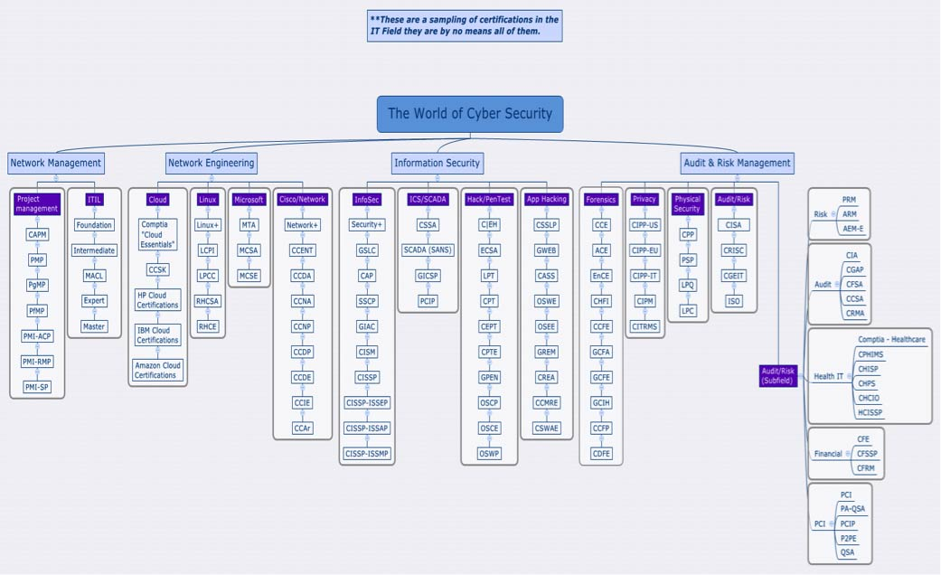

Slide 16
Appendix and Useful Links
The Dark Side of Wearables (http://www.techrepublic.com/article/the-dark-side-of-wearables-how-theyre-secretly-jeopardizing-your-security-and-privacy/)
IoT – Why security is critical (https://techcrunch.com/2015/10/24/why-iot-security-is-so-critical/)
Latest DDOS using IoT (http://searchsecurity.techtarget.com/news/450401962/Details-emerging-on-Dyn-DNS-DDoS-attack-Mirai-IoT-botnet)
Car Hacking (https://www.wired.com/2016/03/fbi-warns-car-hacking-real-risk/)
Cars Programmed to Kill (https://www.technologyreview.com/s/542626/why-self-driving-cars-must-be-programmed-to-kill/)
Big Data, Big Problems (https://techcrunch.com/2016/10/11/how-artificial-intelligence-is-changing-online-retail-forever/)
German Nuclear Plant Attacked (http://www.telegraph.co.uk/news/2016/04/27/cyber-attackers-hack-german-nuclear-plant/)
Hack causes massive damage at steel plant (http://www.bbc.com/news/technology-30575104)
Water Treatment Plant Hacked (http://www.theregister.co.uk/2016/03/24/water_utility_hacked/)
Cyber Warfare – Office of Personal Management (http://time.com/3928086/these-5-facts-explain-the-threat-of-cyber-warfare/)
The Future of War (http://www.defenseone.com/ideas/2015/12/2016-predictions-look-ahead/124668/)
Microchips and Devices (http://www.news.com.au/technology/gadgets/wearables/australians-embracing-superhuman-microchip-technology/news-story/536a08003cb07cba23336f83278a5003)
Hacked Medical Devices (http://www.nextgov.com/cybersecurity/2016/05/unlikely-threat-posed-hacked-medical-devices-va/128608/)

Slide 17
Questions?

