Slide 1
Medical Service Corps AOC 67J Aeromedical Evacuation Officer
Major (ret.) Spencer Cash

Slide 2
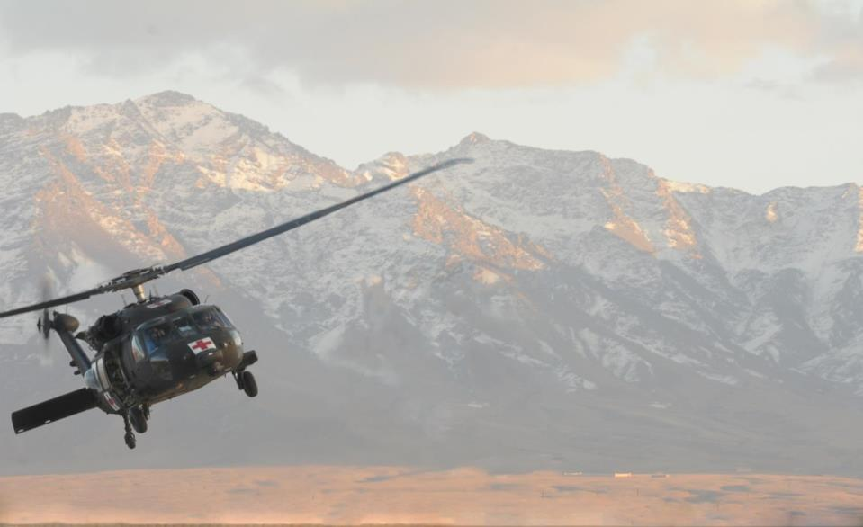
Outline
MSC Overview
Aeromedical Evacuation
Capabilities
Results
Questions

Slide 3
MSC AOC’s
Administrative Health Services
70A- Healthcare Administrator
70B- Health Services Officer
70C- Health Services Comptroller
70D- Health Services Systems Manager
70E- Patient Administrator
70F- Human Resources Manager
70H- Plans, Operations, Intelligence, Training and Security
70K- Medical Logistics
70K9I- Health Facilities Management
67J- Aeromedical Evacuation
670A- Health Services Maintenance Technician
Medical Allied Sciences
71A- Microbiology / Parasitology / Immunology
71B- Biochemistry
71E- Clinical Laboratory
ASI 8T- Blood Bank Officer
Preventative Medicine Services
72A- Nuclear Medical Science
72C- Audiology
72D Environmental Science and Engineering
73B- Clinical Psychology
71F- Research Psychology
Clinical health Sciences
67E- Pharmacy
67F- Optometry
67G- Podiatry
73A- Social Work

Slide 4
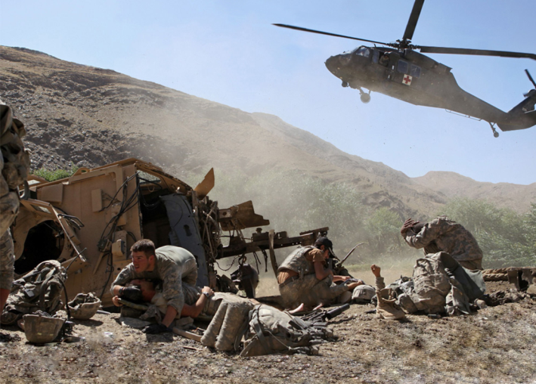
What we do
When your having the worst day of your life, we are there to make sure it is not your last.
Dedicated
Unhesitating
Support
To
Our
Fighting
Forces

Slide 5
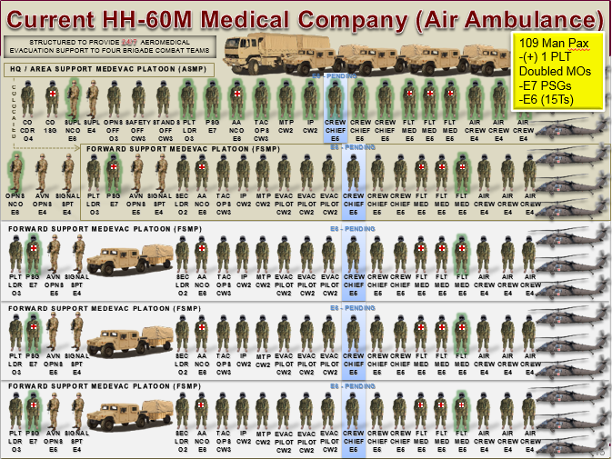

Slide 6
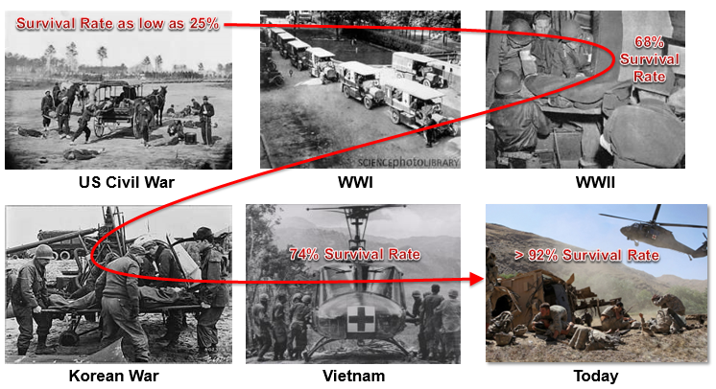
Results

Slide 7
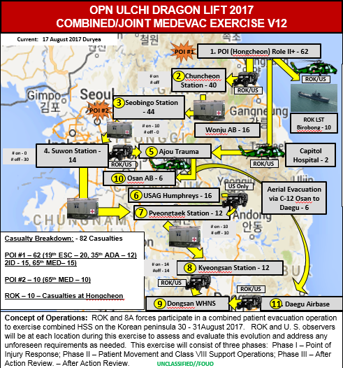
Current Assignment
8th Army Medical Evacuation Officer
Advisor to the Surgeon
Theater Evacuation Plan
Patient Evacuation Coordination Cell
Liaison to ROK Military

Slide 8
Questions?

