Slide 1
How to Invest,
You and Your Money
It's all about what you spend

Slide 2
Save and Invest ! Save and Invest ! Save and Invest !
Words to live by
  Start as soon as possible! What you do today impacts tomorrow!
  When investing at a young age, Risk is your friend!
  Set your investment goals short term and long
  Credit cards can wreck your future
    Needs vs. Wants
  Credit Score
  Follows you for life like a bad tattoo
  401k Plans, Start as soon as possible
    Max out employer contribution
  Fees have a big impact on returns

Slide 3
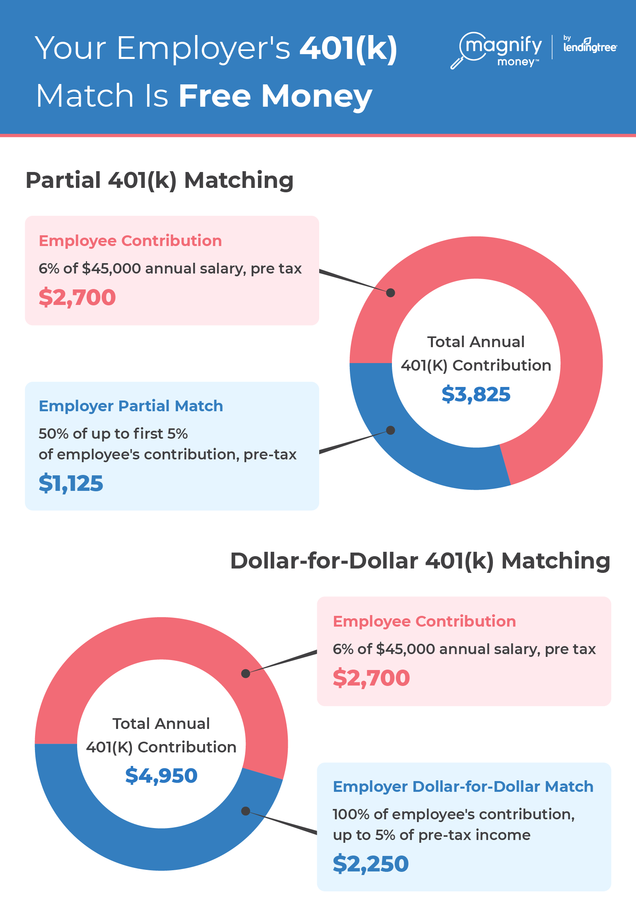
401K Plan
Start As soon as possible
Reduces taxable income
Max out employer match, free money
Set and allocation based on your age
Use target date funds
Monitor once a quarter

Slide 4
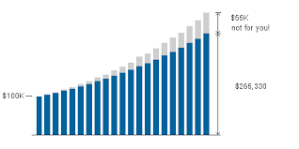
Getting Started
Setting Up an Account
Has never been easier to set up an account
Young people have flexed and made a big impact, GAMESTOP
Select a broker, Robinhood may be the simplest and cheapest
Open account, you will need to provide, Name, Address, Social Security Number
Fund account with available investment capital, AKA money
Fees matter, a mutual fund that charges an annual fee of 1%. That fee sounds small, until you realize that it decreases your return rate by 1% and reduces your final balance by a huge amount.

Slide 5
Mutual and Index Funds
Mutual Funds
Many Types and Styles
Provide Diversification
Index Funds
Low Fees
Broad Market Exposure

Slide 6
Stocks
Value
Growth
Large Cap
Small Cap
Mega cap: $200 billion +
Large cap: $10 billion to $200 billion
Mid cap: $2 billion to $10 billion
Small cap: $300 million to $2 billion
Micro cap: $50 million to $300 million
Nano cap: less than $50 million
Returns
Appreciation
Potential Dividends
Total Return

Slide 7
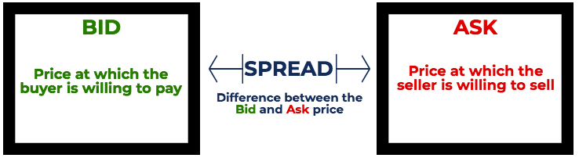
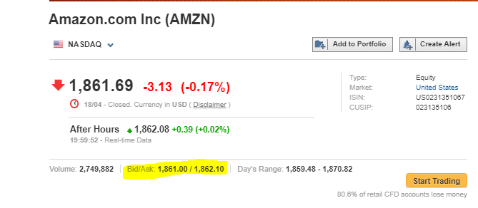
Bid – Ask Spread

Slide 8
Buying and Selling
Types of orders
  Market Order
    Buys stocks at the market price
  Limit Order
    Sets a price limit to buy stock
    Can be set above the market or below
  Stop Loss
    Sells automatically is price falls below a set number

Slide 9
Buying an Investment
Invest in what you know
  What is interesting to you
  What do you love, music, sports, tech
Select a stock, mutual or index fund
How much $ do you want to invest
$ / share price = number of shares to purchase
  Give some room to pay for commissions

Slide 10
The Risk Pyramid
Highest Risk/
Highest Earnings
Lowest Risk/
Lowest Earnings

Slide 11
Dollar Cost Averaging
Invest at VARIOUS times at VARIOUS prices. You buy more shares when prices are lower, less when prices are higher.
(unless you KNOW what the market is going to do).
Dollar Cost Averaging Example
Month Amount Invested Cost per Share No. of Shares
March $100 $20.00 5
April $100 $25.00 4
May $100 $10.00 10
June $100 $50.00 2
Average cost per share $19.05 21

Slide 12
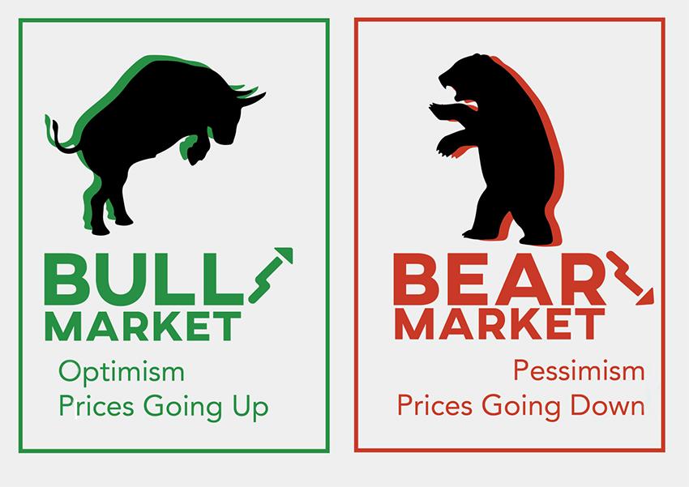


The Animals of Investing
The Chickens are afraid to lose anything.

Slide 13
Lessons Learned
Emotional decisions derail your finances
The worst mistake investors make is taking their profits too soon,
  and holding losses too long.”
You will make mistakes, Cut your losses and move on!
Diversification is essential
The markets are unpredictable in the short-term
Selectively doing nothing may be a prudent strategy
Bad times present great opportunities
Picking the perfect time to invest is an imperfect strategy
One bonus life lesson: Be positive

Slide 14
The Power of Compounding
Working for You or Against
“Compound interest is the most powerful force in the universe.
Compound interest is the 8th wonder of the world.
He who understands it, earns it; he who doesn’t, pays it.”
He also discovered the “Rule of 72”
Albert Einstein
What Is the Rule of 72?
The Rule of 72 is a simple way to determine how long an investment will take to double given a fixed annual rate of return. By dividing 72 by the annual rate of return, investors obtain a rough estimate of how many years it will take for the initial investment to duplicate itself.
72 / annual rate of return = years for a double
72 / 8 = 9 Years
72 / 12= 6 Years

Slide 15
The Power of Compounding
Working for You
By investing small sums, and making average gains you can increase your wealth by understanding compounding
If you invest $200 and it returns 10% a year you will earn $20 in year one
In year two the 10% return is now calculated on $220
Compounding is the escalating effect of returns. As an example, if your $200 investment was returning 10% per year after 10 years you would expect to receive $200 in returns. Actually it is much more than that; over 55% more than that. After 5 years your investment of $200 has gone up to $322. That is a return of $122 not $100 as you first thought
At the end of 10 years your investment is worth $519

Slide 16
The Power of Compounding
Working Against You
You buy a new pair of fancy kicks for $200 with a credit card
Since you are young your credit card will have a high rate, likely 18%
If you pay your credit balance in the first month the shoes will cost $200
In you wait one year to pay, the shoes will cost $236
In year two if you do not pay the balance the shoes cost $278
Year three, $329. A very expensive pair of shoes
This is money you could have invested
Same scenario on the investing side. In three years your $200 is now worth $329.

Slide 17
Key Ratios and Terms
Price-To-Book (P/B) Ratio
  Made for glass-half-empty people, the price-to-book (P/B) ratio represents the value of the company if it is torn up and sold today
Price-To-Earnings (P/E) Ratio
  The price to earnings (P/E) ratio is possibly the most scrutinized of all the ratios. If sudden increases in a stock's price are the sizzle, then the P/E ratio is the steak. A stock can go up in value without significant earnings increases, but the P/E ratio is what decides if it can stay up. An important point to note is that one should only compare P/E ratios among companies in similar industries and markets.
Price-to-Earnings Growth (PEG) Ratio
  Because the P/E ratio isn't enough in and of itself, many investors use the price to earnings growth (PEG) ratio. Instead of merely looking at the price and earnings, the PEG ratio incorporates the historical growth rate of the company's earnings.
Dividend Yield
  It's always nice to have a back-up when a stock's growth falters. This is why dividend-paying stocks are attractive to many investors—even when prices drop, you get a paycheck. T
The Bottom Line
  The P/E ratio, P/B ratio, PEG ratio, and dividend yields are too narrowly focused to stand alone as a single measure of a stock. By combining these methods of valuation, you can get a better view of a stock's worth.

Slide 18
Investment Analysis
Equity Classifications
1. Information Technology
2. Health Care
3. Financials
4. Consumer Discretionary
5. Communication Services
6. Industrials
7. Consumer Staples
8. Energy
9. Utilities
11. Materials
Many ways to evaluate investments
Types of analysis
  Fundamental
  Top Down
  Bottom Up
  Quantitative
  Sector Rotation
  Dartboard

Slide 19
Investment Analysis
Resources
List of Resources
www.moneychimp.com/
www.iinvest.org/wp-content/uploads/2018/08/IPI_Stocks_Booklet.pdf
www.nerdwallet.com/article/investing/how-to-invest-in-your-20s
www.nerdwallet.com/article/investing/how-to-buy-stocks?
www.nerdwallet.com/best/investing/online-brokers-for-beginners?
www.cnbc.com

