Slide 1
Physical Therapy
A Dynamic Healing Profession
John M. DiCapo DPT
Physical Therapist National Therapy Director
Business Intelligence and Operations

Slide 3
Today’s Roadmap
What does a Physical therapist do
What is a day as a Physical therapist like
What skills or traits are important to have if you want to be a physical therapist
What setting do Physical therapists work in
Job outlook and compensation
How to become a physical therapist (educational requirements)
Similar rehab profession (PTA, OT, COTA, Speech therapy)
My Journey
Questions

Slide 4
Where Do Physical Therapists Practice?
Outpatient clinics or offices
Inpatient rehabilitation facilities, Skilled nursing, Homes
Education or research centers
Schools
Industrial, workplace, or other occupational environments
Fitness centers and sports training facilities

Slide 5
What types of patients do Physical therapists see
Geriatrics (elderly)
Complex Medical Conditions
Neurological
Orthopedic
Sports
Wound
Children and Babies
Women’s Health
Cardio Pulmonary

Slide 6
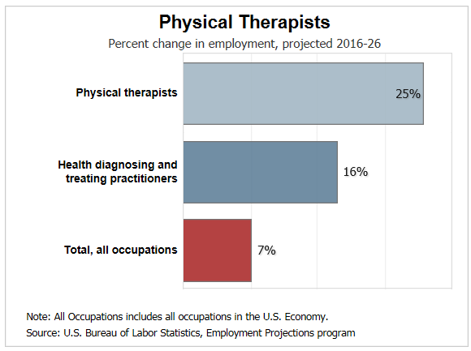

Slide 7
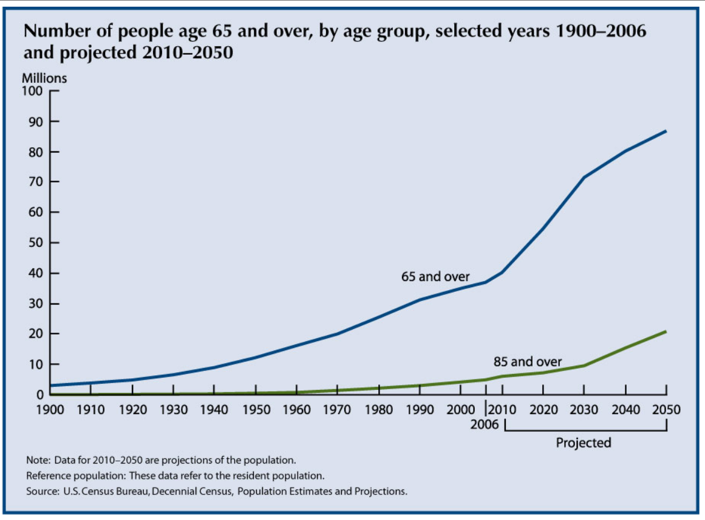

Slide 8
What Are the Educational Requirements for Becoming a PT?
Bachelors degree (normally science related, but not required just have to complete prerequisites) (~4 years)
A graduate degree from an accredited physical therapist program either a masters or clinical doctorate - from an accredited education program. (~3 years, normally year round, some programs have direct admit so 6 years total undergrad and grad)
Program consists of in class learning and clinical practice (~30 weeks of clinical practice)
Pass National Board Exam
Licensed in the state to practice

Slide 9
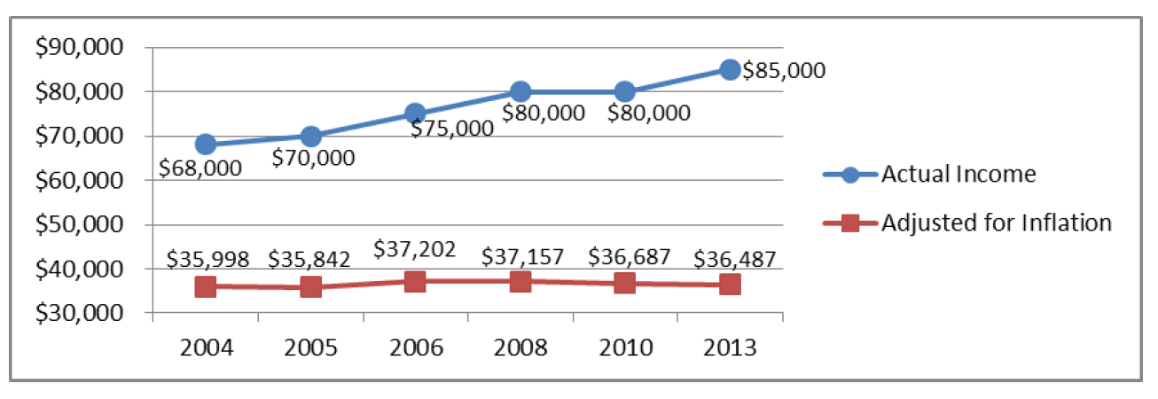
Physical Therapy Compensation

