Slide 1

Hour of Code: Video Games and Graphics

Slide 2

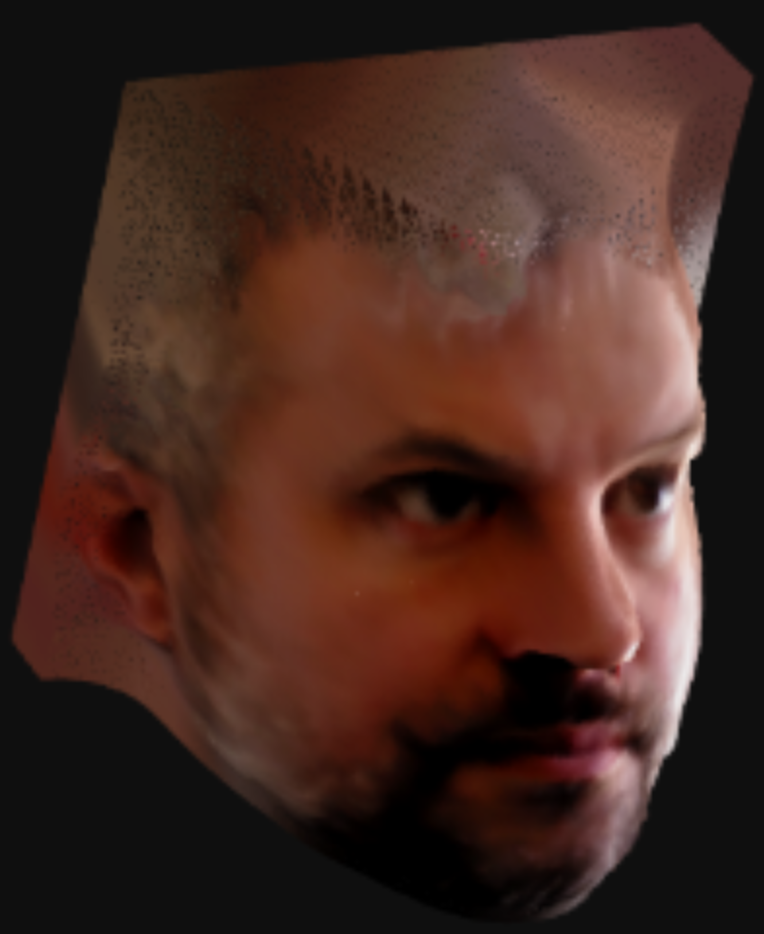
Introductions
Jason Plumb
Graphics
Software
Engineer
Giselle gomez
Technical Consulting Engineer
Notes:
How did you get interested in CS?
Why did you get into programming?
How long did school take?
How much has the CS world changed since you started working/going to school?

Slide 3
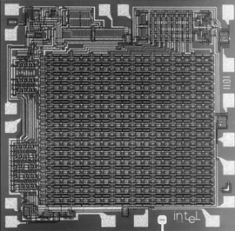
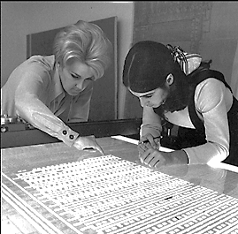
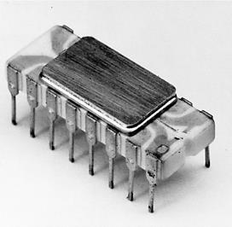

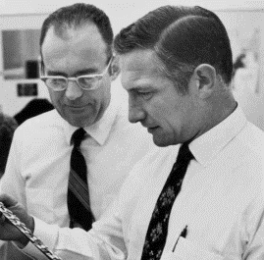
History of Intel
1968: Intel is founded by Robert Noyce and Gordon Moore
1971: World’s first microprocessor
Now: Innovation that expands the reach and promise of computing
Notes:
Back in 1968, two scientists, Robert Noyce and Gordon Moore, founded Intel with a vision for semiconductor memory products.
By 1971, they had introduced the world’s first microprocessor.
1965 – Moore’s Law - the observation that the number of transistors in a dense integrated circuit doubles approximately every two years
Since then, Intel has established a heritage of innovation that continues to expand the reach and promise of computing while advancing the ways people work and live worldwide.
Intel Today:
Leading Manufacturer of Computer, Networking and Communications Products
Headquartered in Santa Clara, California
$55.4B in 2015 Annual Revenue – Over 25 Consecutive Years of Positive Net Income
Over 100,000 Employees, 190 Sites in 90+ Countries

Slide 4


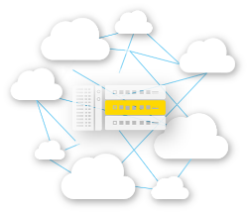










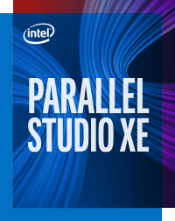











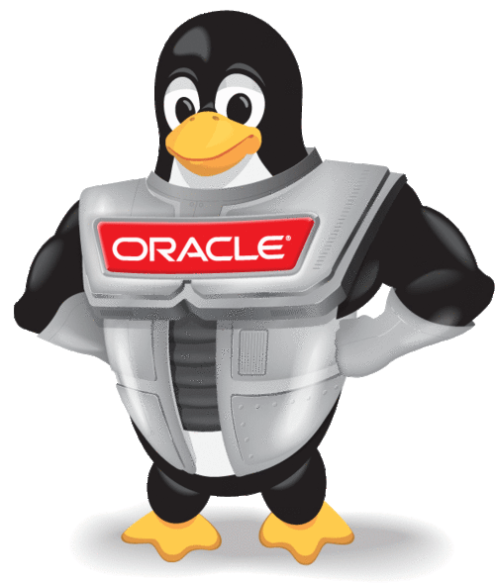




intel software: extensive Value
Things
Network
Cloud/Data Center
010101011101001010110101010101010101010111010010101110101010101
010101011101001010110101010101010101010111010010101110101010101
010101011101001010110101010101010101010111010010101110101010101
010101011101001010110101010101010101010111010010101110101010101
Ecosystem
Enabling
Intel® Developer Zone
Platform Security
Wind River® Simics
Intel® Context Sensing
Intel® CoFluent™ Technology
Brillo
OS
Enabling
…among others…
Notes:
From the things, into the network, and into the cloud… Intel is the only company whose solutions expand across these segments
To successfully serve market segments, we have developed a broad range of processors
We have several business units that focus on delivering solutions to our customers using our leading edge processors
Client Computing Group – focuses on delivering innovation to users through enhanced computing experiences based on Intel architecture-based products
Internet of Things Group – delivers the leading spectrum of solutions from things through gateway and network infrastructure to the cloud
Data Center Group - addresses the breadth of opportunity and diverse requirements of our increasingly digital world and provides foundational components across server, storage and network
New Technologies Group – heart of innovation at Intel with the goal to shape the future of computing through the strategies of enabling sensification, building new ecosystems, and fostering emerging customers. This group is comprised of Intel Labs, Perceptual Computing, New Devices Group, New Business Initiatives, and the Maker and Innovator Group.
Non-Volatile Memory Solutions Group – delivers cutting edge memory and storage solutions in client and server businesses using NAND, 3DNAND, SSD, and 3D Cross Point technologies
Intel Security Group - unites the previously disparate security groups under a single vision – to deliver universal security to individuals and business on all computing devices
Programmable Solutions Group – formerly Altera, focused on Field Programmable Gate Array (FPGA) technology delivery and implementation
Intel is unique because we can deliver solutions across these business units and produce integrated, complete results rather than segmented or partial solutions that only solve part of the customer’s issues.
As data drives the need for accelerated cloud build out and users become more and more reliant on the analytics that data will provide, the virtuous cycle becomes prevalent in our world. The power of Intel is our ability to transcend boundaries across our business units to collaborate and provide the most robust, innovative solutions
Intel delivers software products and influences the ecosystem to unleash the power of Moore’s Law to bring smart, connected devices to every person on the earth.
We accelerate Intel time to market in hardware by driving velocity and momentum into the virtuous cycle through the use of software.
Hardware may be the tangible vehicle to deliver IA solutions, but software is the invisible ingredient that makes it all work together.
Our BROAD & DEEP software competence makes this possible
BREADTH - from the device edge (“Things”), through the network to the Data Center/Cloud
DEPTH – top to bottom of SW stack: from integrated platform security, firmware/middleware/cross-platform optimizations, operating system enabling, ISV/App enabling, and developer enabling with development tools.
Simply put, we activate capabilities in our Intel Hardware to deliver amazing products and/or experiences to end users. Whether that’s through work we do internally here at Intel along with our ecosystem partners, or through the products/tools that we provide to millions of software developers to be able to do that themselves.
Our work can be categorized into 3 main areas:
We ensure software compatibility for IA-based products (eg Operating System upstream code contribution & enabling for compatibility for the latest IA roadmap – whether that’s Windows (client, IoT, Server), Android, Chrome, Brillo, Apple or regional OSVs such as Yun OS, &/or projects such as the Yocto Project to make it easier for our partners to design a customized version of the Linux Kernel to support unique needs, such as IVI.
We deliver tuning/optimizations to software & open source projects to ensure it runs better/faster on IA-based products, eg optimizations on Deep Learning Frameworks such as Caffe and Theano in support of Machine Learning; or tuning/optimizations on Apache Spark to ensure real-time data analytics runs best on IA
And finally we deliver unique/differentiated apps/experiences to the end user through the work we do in support of the ecosystem, and the tools/support we provide to developers and ISVs around the world (eg, a full roadmap of developer tools offerings to enable developers to get the absolute best out of their platforms, and design applications/software from the ground up based on IA; integrating critical security features into the IA hardware from roadmap conception to advance security; advocating for industry standards such as the Open Connectivity Foundation (Intel one of founding members) to drive seamless inter-operability and inter-connectivity across all devices; or driving a Developer Program with Events, and Hackathons to fuel developer innovation.
Some SSG proofpoints:
Microsoft - Intel (& specifically the Windows OS team in SSG) are the only people working on MSFT software development outside of MSFT themselves. Our Microsoft partners trust WOS to have direct access to code, enhance it for IA and even check into their live development trees for bugs etc. Putting that into perspective, for Intel, this would be the equivalent to us letting an external company add design code to our CPU/SOC designs actively during product development. SSG’s WOS has supported 11 generations of Windows OS and 17 generations of Intel products. The number of feature requests we enabled grew from ~40 requests a decade ago to 350 for Windows 10.
Linux - In open source, Intel is the #1 contributor to Linux and we are one of top contributors to AOSP/Chromium
In support of the Cloud/DC, we contribute to open source code in particular to OpenStack & Apache Spark: In the top 6 contributors to OpenStack, Platinum member of OpenStack Foundation, #4 Apache Spark contributor
Driving the ecosystem/scale: To support this value that Intel brings end-to-end in the software space, the Intel Developer Program is designed from the ground up to support our network of software developers. As of 2015 statistics (Benchmarking research for Intel’s Developer Program, Evans Data Corporation, 2015) show that it is #4 in size and #2 on quality. In 2015 we engaged with: 16M Developers, 6660 ISVs, 1267 apps enabled, 520 differentiated apps. Different types of developers (entrepreneurial, enthusiast and hobbyist developers) & several different developer languages.

Slide 5




Corporate Responsibility at Intel
Environmental Sustainability
Supply Chain Responsibility
Diversity & Inclusion
Social Impact
www.intel.com/responsibility
www.intel.com/diversity
Notes:
Intel innovates at the boundaries of technology to make amazing experiences possible for business and society, and for every person on Earth. Intel’s long-standing commitment to corporate responsibility creates value for Intel and our stakeholders, helping us manage our business more effectively to mitigate risks, reduce costs, protect brand value, and identify new market opportunities. This commitment rests on a foundation of an ethical business culture, strong governance practices, and a history of transparency.
As a technology and business leader, we tackle the toughest global challenges by leveraging our technology and employee expertise in the areas of: environmental sustainability, supply chain responsibility, diversity and inclusion, and social impact.
Environmental sustainability
Our sustainability practices drive efficiency, lower costs, decrease negative impacts on the communities where we operate, and reduce resource use. The Intel Code of Conduct and our Climate Change Policy, Water Policy, and Environmental, Health, and Safety Policy guide our sustainability strategy and helped us set our 2020 environmental goals. Multiple groups across Intel drive our progress in achieving our goals, and we work to engage all of our employees in helping to reduce our environmental impact. We also work collaboratively with governments, environmental groups, and other companies to broaden our impact in addressing environmental issues.
Designing energy efficiency into our cloud and data center platforms is a critical part of Intel’s virtuous cycle of growth. Our products help our customers build high-performing solutions that lower their operating costs and reduce their carbon footprint. It’s one of our key competitive advantages. Platforms using the recently introduced Intel® Xeon® processor E5-2600 v4 product family deliver up to 50% improvement in energy efficiency compared to the previous generation of platforms. (reference: Annual Corporate Responsibility Report – www.intel.com/responsibility)
Supply chain responsibility
Intel has a long-standing commitment to promoting transparency and driving continuous corporate responsibility improvements in our supply chain. Our multi-tiered supply chain comprises more than 19,000 suppliers in over 100 countries. Actively managing our supply chain creates business value for Intel and our customers by helping us reduce risks, improve product quality, achieve environmental goals, and raise the overall performance of our suppliers. The percentage of participating suppliers who have met all of the requirements in Intel’s Program to Accelerate Supplier Sustainability has increased from 57% to 79% in just three years.
Intel was one of the first companies to address the issue of “conflict minerals”* from the Democratic Republic of Congo (DRC) or adjoining regions. In 2013, Intel met its goal to manufacture microprocessors that are “conflict-free”** for tantalum, tin, tungsten, or gold, and is on track to meet our 2016 goal to validate that our broader product base is conflict-free for these minerals.
Diversity and inclusion
We believe that the tech industry is stronger and more innovative when we are more diverse and inclusive. Inclusion means ensuring that all employees are, and feel, free to bring their full selves to work, offer their unguarded perspectives, and find a welcoming and inviting place for those ideas. In early 2015, we set an ambitious goal to be the first high-tech company to reach full representation of women and underrepresented minorities in our workforce by 2020. We committed $300 million to support this goal and accelerate diversity and inclusion both at Intel and across the technology industry. We achieved strong results toward this goal throughout the year.
We have been committed to supplier diversity for many years, but in 2015 we greatly strengthened that commitment with a new goal to increase our spending with diverse suppliers to $1 billion by 2020. Further underscoring our broad commitment to diversity and inclusion, we announced the Intel Capital Diversity Fund in 2015. This fund is focused on investing $125 million over five years in a broad spectrum of women-and minority-led companies.
Social impact
Through multiple initiatives, Intel is enabling young people around the world to acquire the innovation and technology skills they need to prepare them to succeed in today’s digital economy. This includes maker events and programs that facilitate innovation and learning experiences with youth–particularly those in underserved areas. To date, Intel has led over 300 programs in more than 100 countries to support student achievement.
Many of our initiatives also address gender gaps that exist in access to technology and education, including the Intel® She Will Connect program which helps women acquire digital literacy skills and access the benefits of the Internet. As part of the initiative, we set an ambitious goal to reduce the Internet gender gap by 50% in sub-Saharan Africa by reaching 5 million women by 2020.
Intel Education reaches 150M Students Learning and Creating with Technology, 15M Teachers Empowered with Professional Development, and contributes over 4M Employee Volunteer Hours for Education.
The Intel Foundation extends the impact of Intel’s employee volunteerism by providing matching funds to the nonprofits and schools where employees and retirees donate their energy and skills to tackle environmental challenges, improve education, and help meet other community needs. Over the past five years, the Intel Foundation paid almost $42.7 million in matching grants in support of our employees’ 6.1 million hours of service.
Learn more about Corporate Responsibility at Intel and our progress to goals at www.intel.com/responsibility
Footnotes:
*“Conflict minerals,” as defined by the U.S. Securities and Exchange Commission (SEC), is a broad term that means tin, tantalum, tungsten, and gold, regardless of whether these minerals finance conflict in the Democratic Republic of the Congo (DRC) or adjoining countries
**"Conflict-free" refers to products, suppliers, supply chains, smelters, and refiners that, based on our due diligence, do not contain or source tantalum, tin, tungsten or gold that directly or indirectly finance or benefit armed groups in the Democratic Republic of the Congo or adjoining countries.

Slide 6




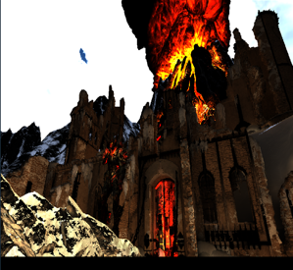
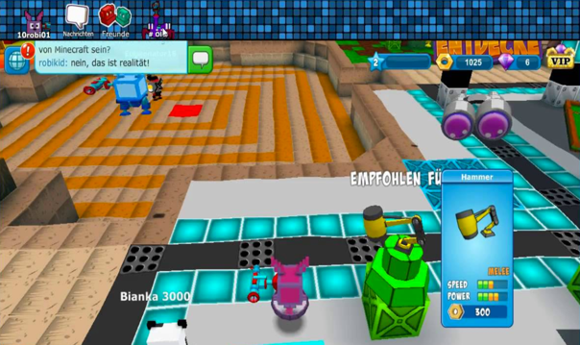

Intel® Graphics Performance Analyzers (Intel® GPA)
PC | Virtual Reality | Mobile

Slide 7
Resources: Learn More about coding
Free coding courses: https://www.codecademy.com/
Learn turtle: http://www.calormen.com/jslogo/
More guided activities: https://studio.code.org/courses
Kano: https://kano.me/store/us/products/computer-kit-complete
Python resources:
  https://cacm.acm.org/blogs/blog-cacm/176450-python-is-now-the-most-popular-introductory-teaching-language-at-top-u-s-universities/fulltext
  https://ocw.mit.edu/courses/electrical-engineering-and-computer-science/6-0001-introduction-to-computer-science-and-programming-in-python-fall-2016/

Slide 8
Q & A
What are some questions you have for us?
Notes:
What’s your favorite language?
What was the hardest thing about studying CS?
What has been one of your favorite work/internship experience?

