Slide 1
Careers in Medical Fields
Jennifer Schrandt
Jennifer.Schrandt@stonybrook.edu
Stony Brook University

Slide 2
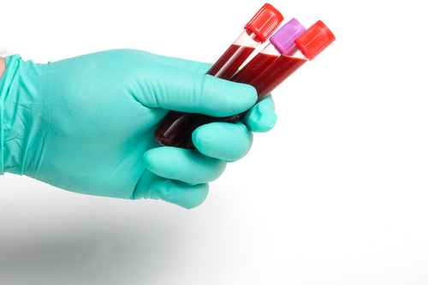
Phlebotomy Technician
Collect blood samples
National Accrediting Agency for Clinical Laboratory Sciences
Certificate program
6-16 weeks
At least 42 hours of classroom training
At least 120 hours of clinical experience
Phlebotomy certifying examination
Offered by American Medical Technologists, American Society of Phlebotomy Technicians, and National Healthcareer Association
Agency determined by employer
Up to 5-6 hours of continuing education per year
Average annual salary around $28,000-$31,000

Slide 3
Ultrasound Technician
Use equipment to generate images of the body’s internal structures
Generally requires Associate’s Degree, but there are also Bachelor’s and 1-year certification programs
American Registry for Diagnostic Medical Sonography
Registry not required by state, but many employers prefer it
Requires an exam
Average annual salary around $60,000-$66,000

Slide 4
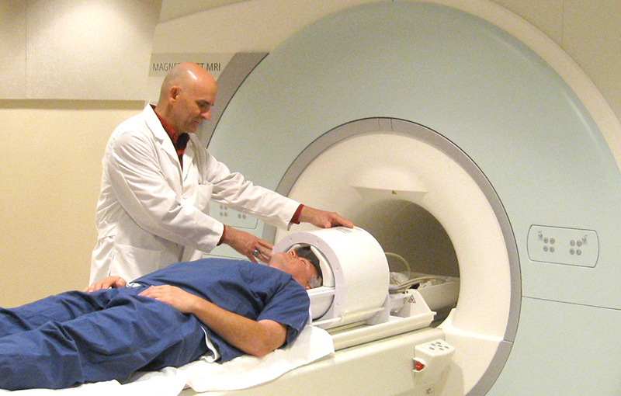
Radiology Technician
Training requirements similar to an ultrasound technician
The Joint Review Committee on Education in Radiologic Technology
Consider specializing
American Registration of Radiologic Technologists certification
Requires 24 hours of continuing education every 2 years
Fields:
Mammography
Computer tomography
Magnetic resonance imaging
Radiography
Cellular imaging
Medical sonography
Medical imaging
State licensing
Average annual salary around $56,000-$62,000

Slide 5
Nurse (RN)
Associate’s or Bachelor’s degree in nursing
Bachelor’s degree provides more clinical experience
National League for Nursing Accrediting Commission
State licensure: National Council Licensure Exam (NCLEX-RN)
Specialty certifications
Average annual salary around $58,000-$70,000

Slide 6
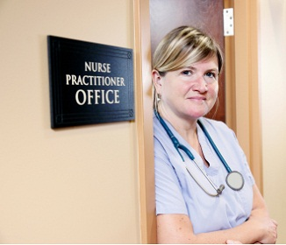
Nurse Practitioner (NP)
Advanced practice registered nurses
Bachelor of Science in Nursing
Requires either Master of Science in Nursing (MSN) or Doctor of Nursing Practice (DNP)
DNP requires a research project or residency
DNP is currently becoming more common
MSN—1.5-2 years full-time
DNP—2-3 years full-time
State licensure: National Council Licensure Exam (NCLEX-PN)
States where NPs can prescribe: AK, AZ, DC, IA, ME, MT, NH, NM, OR, UT, WA, WI, WY
Average annual salary around $87,000-$96,000

Slide 7
Physician Assistant (PA)
American Academy of Physician Assistants
Master’s degree, sometimes a Bachelor’s degree program
Usually 2-3 years for Master’s degree
At least 2,000 hours of clinical rotations for Master’s
Nationally certified
State licensed
100 hours of continuing medical education every 2 years
Average annual salary around $84,000-$97,000

Slide 8
Family Medicine Doctor (MD or DO)
Doctor of Medicine (MD) or Doctor of Osteopathy (DO)
MD is more common and practices allopathic medicine
DO trained to have more holistic approach, and requires additional 200 hours of training in osteopathic manipulative medicine
Both are 4 year medical school programs with 3-7 years of residency
MD students take United States Medical Licensing Exam (USMLE)
DO students take Comprehensive Medical Licensing Exam (COMPLEX)

Slide 9
Family Medicine Doctor (MD or DO)
Residency:
Already attained an MD or DO
Practice medicine under supervision of the attending physician
Required for licensing
Steps required:
Interviewing
Match (students and residency programs rank each other and are then matched)
Internship (first year of residency)
Following the intern year, student can take the licensing exam to practice as a general practitioner or complete a 2-7 year specialty track
Fellowship:
Optional following residency
May act as attending physician
Mainly serves in sub-specializing, so it’s not common for a family doctor

Slide 10
Family Medicine Doctor (MD or DO)
Requires continuing education credits
Average annual salary around $187,000-$195,000

Slide 11
Physical Therapist
Doctor of Physical Therapy
Typically 3 years
Typically 27.5 weeks in clinical experience
Optional clinical residency or clinical fellowship
Commission on Accreditation in Physical Therapy Education
Specialty certification options:
Cardiovascular and pulmonary
Clinical electrophysiology
Geriatrics
Neurology
Orthopaedics
Pediatrics
Sports physical therapy
Women’s health
State licensure
Average annual salary $67,000-$88,000

Slide 12
Pharmacist
Doctor of Pharmacy
Usually 4 years
7-10 clinical rotations of 4-6 weeks each
North American Pharmacist Licensing Exam (NAPLEX)
Multistate Pharmacy Jurisprudence Examination
Optional residency or fellowship
Average annual salary around $108,000-$121,000

Slide 13
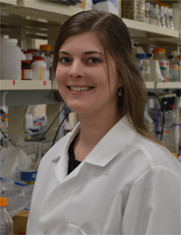
Medical Research Scientist
Requires Ph.D. (~5-6 years)
Curriculum varies by university
Generally first 2 years for classwork and research
Qualifier exam (usually during 2nd year)
Thesis proposal (usually during 3rd year)
After completing coursework, the rest of the time is devoted to research
Thesis defense
Often requires post-doctoral fellowship (at least 2 years)
Careers:
Pharmaceutical industry (GlaxoSmithKline)
Government (NIH) or non-profit (St. Jude)
University
Average annual salary around $100,000-$150,000 in pharmaceutical industry

Slide 14
Questions?
Jennifer.Schrandt@stonybrook.edu

