Slide 1
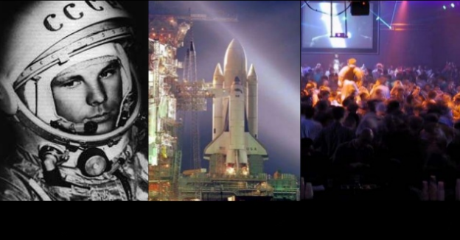
2017 Yuri’s Night
APRIL 12th
Veronica Ann Zabala-Aliberto “VAZA”
Yuri’s Night Community Manager
Rock The Planet !
veronica@yurisnight.net
Rock The Planet !
1961
1981
2017
Image credit: Yuri’s Night

Slide 2
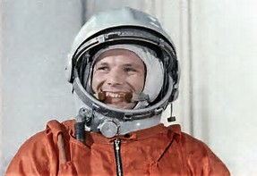
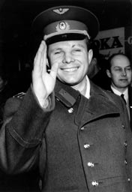
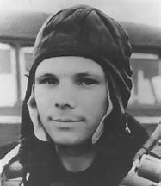
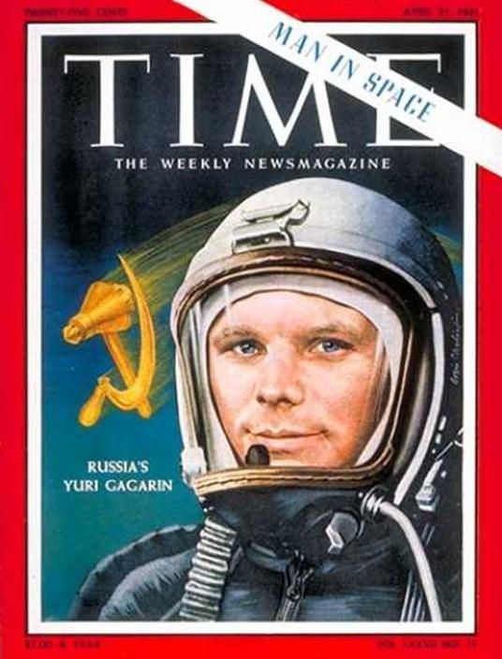
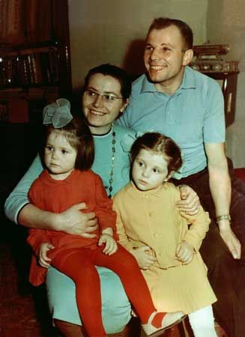
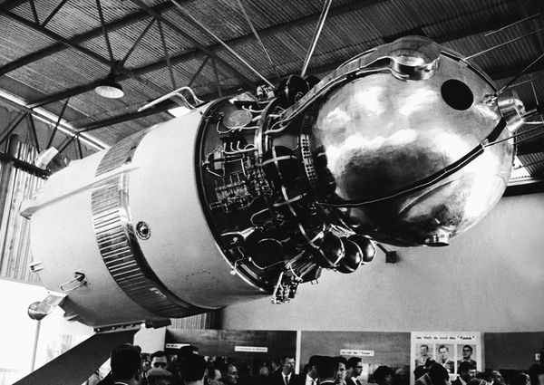
Who was Yuri Gagarin?
9 March 1934 - 27 March 1968 (34 years old)
Yuri was a military pilot
Time in Space: 1 hour, 48 minutes
Mission: Vostok 1
Launched from Baikonur Cosmodrome
He became both the first human to travel into space, and the first to orbit the Earth.
Image credits: NASA

Slide 3
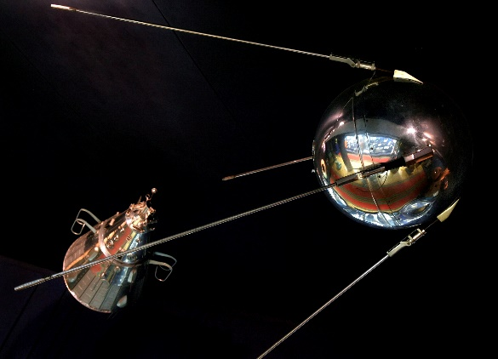
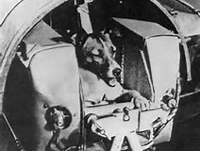
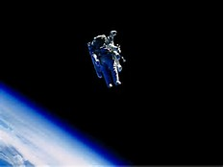
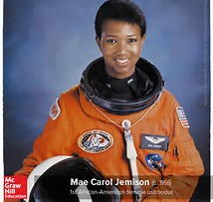
“Firsts” in Space
THE FIRST PERSON TO MAKE A SECOND TRIP INTO SPACE:
Gemini 3, the first piloted Gemini flight, included Virgil "Gus" Grissom among its crew as it lifted off in March of 1965. He had previously flown in space in July, 1961 aboard the second suborbital Mercury mission.
THE FIRST EARTHLING IN SPACE:
Laika, a dog, was launched into space on the Sputnik 2 in 1957. She survived the launch and for a time in space, but after a week, the air ran out and Laika died.
THE FIRST AFRICAN-AMERICAN IN SPACE:
August 30, 1983, the space shuttle Challenger lifted off with Guion "Guy" Bluford, Jr., the first African American in space.
THE FIRST AFRICAN-AMERICAN WOMAN IN SPACE:
Mae Jemison lifted off in the space shuttle Endeavour on September 12, 1992, first African American woman in space.
THE FIRST HUMAN IN SPACE:
Yuri Gagarin, a cosmonaut from the USSR, was launched into space on April 12, 1961 aboard the Vostok 1. His flight lasted one hour and forty-five minutes, orbiting the Earth one time. Describing the view of the Earth from space, Gagarin radioed, "It has a very beautiful sort of halo, a rainbow."
THE FIRST SPACE WALK:
Alexei Leonov, a Soviet cosmonaut, was the first person to step outside of his spacecraft while in space, on March 18, 1965. He spent 12 minutes as he floated as far as 17.5 feet from his Voskhod 2 craft, enjoying the first space walk ever.
THE FIRST AMERICAN IN SPACE:
Alan Shepard was launched into space aboard Mercury 3 on May 5, 1961 to become the first American in space. His craft did not achieve orbit, but rose to a height of 116 miles and traveled 303 miles before safely parachuting into the Atlantic Ocean.
THE FIRST AMERICAN TO WALK IN SPACE:
During the Gemini 4 mission, Ed White made a 21 minute EVA (Extra-Vehicular Activity), also known as a space walk.
THE FIRST AMERICAN TO ORBIT THE EARTH:
On February 20, 1962, the Friendship 7 capsule carried astronaut John Glenn around the Earth three times on a five-hour space flight.
He was the first American to orbit our planet.
THE FIRST AMERICAN WOMAN TO PILOT A SPACECRAFT:
Eileen Collins piloted the space shuttle Discovery in 1995.
THE FIRST MAN ON THE MOON:
With his famous words, "That's one small step for man, one giant leap for mankind." Neil Armstrong, on the Apollo 11 mission, stepped onto the Lunar surface on July 20, 1969, becoming the first man on the Moon.
THE FIRST WOMAN IN SPACE:
Valentina Tereshkova flew in space aboard the Vostok 6 on June 16, 1963.
THE FIRST AMERICAN WOMAN IN SPACE:
On June 18, 1983, the space shuttle Challenger lifted off with Sally Ride aboard. She was the first American woman in space.
THE FIRST RE-USABLE ROCKET:
Although both SpaceX and Blue Origins have been developing re-usable rockets to lift people and payloads to space, the first launch of a re-usable was made by Blue Origins on November 23, 2015.
Image credits: NASA

Slide 4
Empowerment = Leaders
Anyone can be a Yuri’s Night Host
Educate & Inspire EVERYONE !!!
Celebrated around the world, on the International Space Station (ISS) and has even been on spacecraft to other planets !!!
Many organizations host Yuri’s Night venues around the world !!!
Video credit: Yuri’s Night

Slide 5
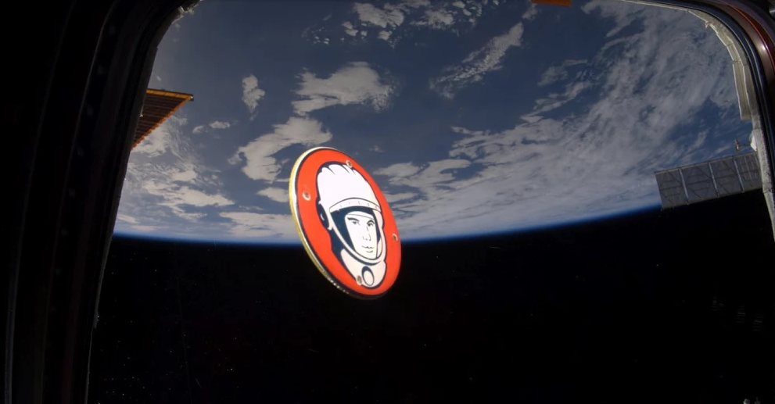
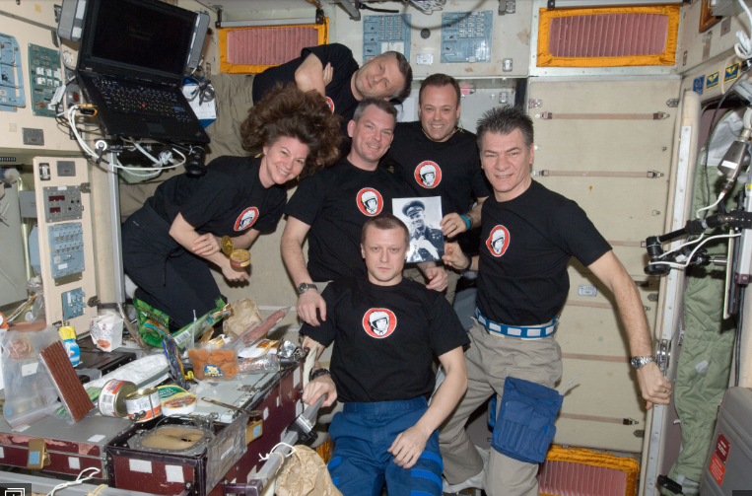
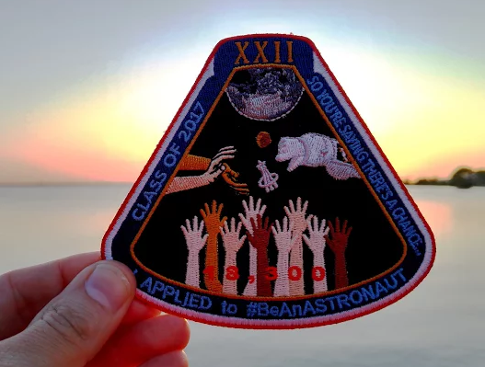
Empowerment = Leaders
Anyone can be a Yuri’s Night Host
Educate & Inspire EVERYONE !!!
Celebrated around the world, on the International Space Station (ISS) and has even been on spacecraft to other planets !!!
Empowerment = Leaders
Anyone can be a Yuri’s Night Host
Educate & Inspire EVERYONE !!!
Celebrated around the world, on the International Space Station (ISS) and has even been on spacecraft to other planets !!!
Many organizations host Yuri’s Night venues around the world !!!
Image credit: NASA
Image credit: Yuri’s Night
Image credit: Yuri’s Night
Image credit: Yuri’s Night

Slide 6
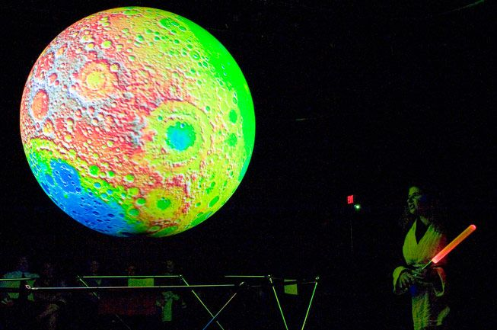
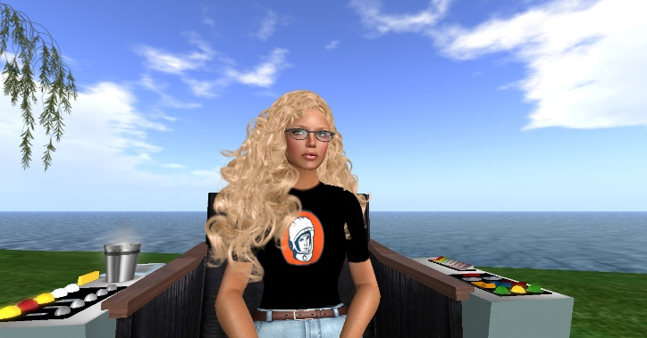
Promoting STEM / STEAM
SCIENCE
TECHNOLOGY
ENGINEERING
MATHEMATICS
ART
Image credit: Yuri’s Night
Image credit: V.A. Zabala-Aliberto
YURI’S NIGHT = EDUCATION OUTREACH

Slide 7
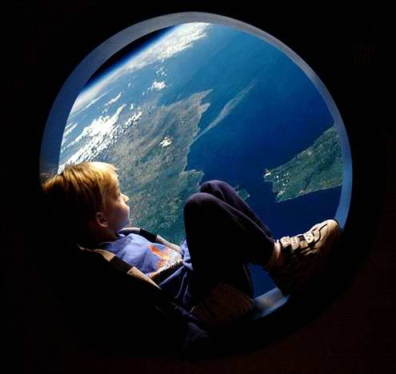
Past, Present & Future
1. Gives True Perspective: What where their successes? What did they learn? It’s important to reflect on experiences because human beings have the tendency to take things for granted.
2. Gives Emotional Integrity: Most individuals who enjoy the thrill of an experience try to go back and recapture it without first trying to evaluate it.
3. Gives Confidence in Decision-Making:
What factors played a role in that decision?
What steps did they take in making that decision?
Was that decision a good one? Why or why not?
4. Helps Keep the Big Picture in Mind: Richard Branson, the founder of Virgin Group, says, “My biggest motivation? Just to keep challenging myself. I see life almost like one long University education that I never had—everyday I’m learning something new.”
5. Takes a Good Experience and Makes It a Great Experience: It’s not necessarily experience that is valuable; it’s the insight leaders gain because of the experience. Looking back enables leaders to turn whatever happened before into improvements for the future.
Image credit: spacefeelings.com
PREPARE FOR THE FUTURE . . .
READ SCIENCE FICTION ! ! !

Slide 8
To further our understanding of our own Home World !
Because it is there !
Push the boundaries of our scientific and technical limits !
What’s YOUR Reason(s)?
So I can swim in the Nitrogen lakes on Titan !
Create friendly relationships with other nations !
To find a new home with fresh resources (ie: Water, Clean Air, etc.)
To answer questions about the history of our Solar System!
To find a new home with fresh resources (ie: Water, Clean Air, etc.)
Because I will look so cool in a spacesuit !
Why Space Exploration?
Video credit: Yuri’s Night

Slide 9
What is “Yuri’s Night”?
Yuri's Night is an international celebration held every April 12 to commemorate milestones in space exploration. Yuri's Night is named for the first human to launch into space, Yuri Gagarin, who flew the Vostok 1 spaceship on April 12, 1961. The launch of STS-1, the first Space Shuttle mission, is also honored, as it was launched 20 years to the day of Vostok 1 on April 12, 1981.
1961
1981
2017
Image credit: Yuri’s Night

Slide 10
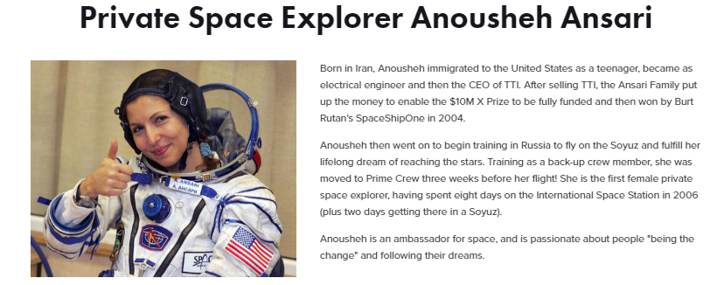
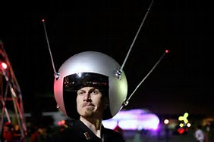
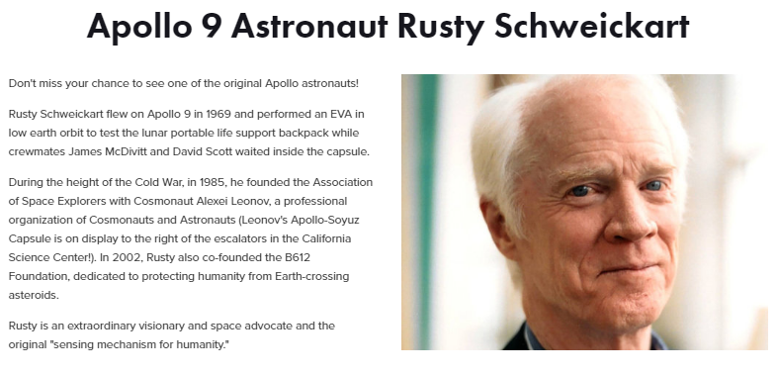
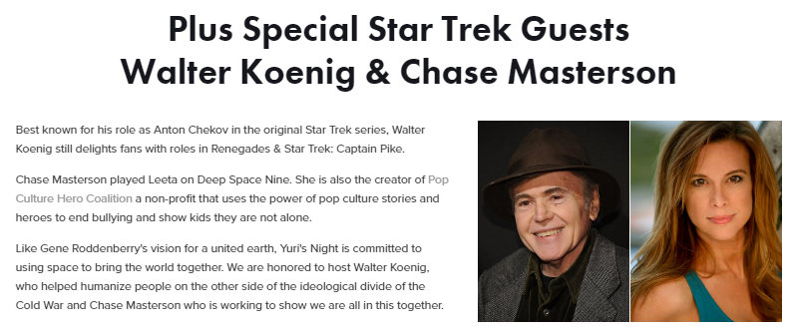
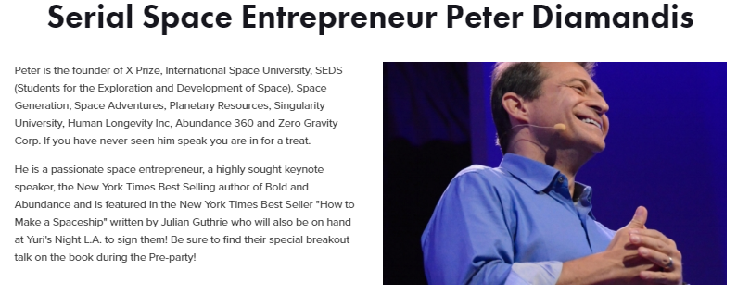
What is “Yuri’s Night”?
2017 Los Angeles
Yuri’s Night
Yuri's Night is an international celebration held every April 12 to commemorate milestones in space exploration. Yuri's Night is named for the first human to launch into space, Yuri Gagarin, who flew the Vostok 1 spaceship on April 12, 1961. The launch of STS-1, the first Space Shuttle mission, is also honored, as it was launched 20 years to the day of Vostok 1 on April 12, 1981.

Slide 11
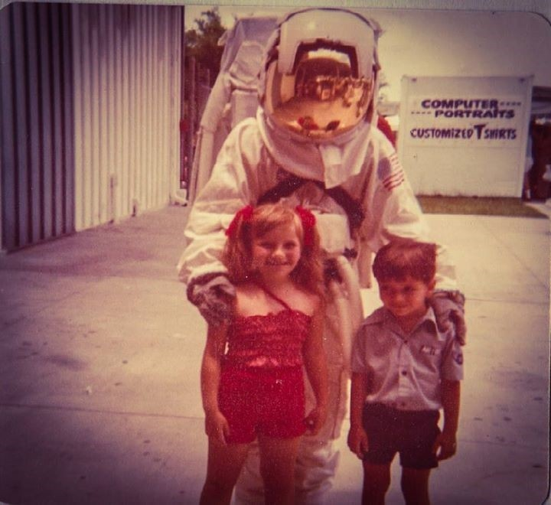
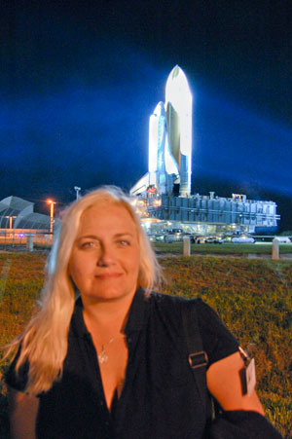
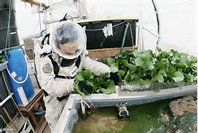
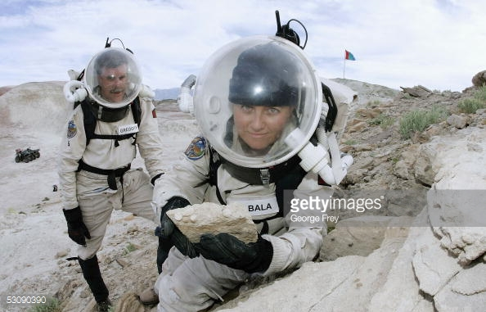
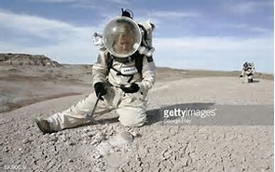
What’s it like to be an ASTRONAUT ???
Exciting
Dream it . . . Live it !
Never Give Up !
Educational
Never stop learning !
Teach others what you learn !
Inspirational
Share your successes & failures !
Influence & motivate others ! Lead by example !!!
Image credit: V.A. Zabala-Aliberto
Image credit: V.A. Zabala-Aliberto

